Slide 1
Chapter 8: Muscular System
A&P130 North-West College
Ms. Escoto

Slide 2
Intro
Muscular tissue enables the body and its parts to move
Three types of muscle tissue exist in body Movement caused by muscle cells (called fibers)
Shortening or contracting
Muscle movement occurs when chemical energy (obtained from food) is converted into mechanical energy

Slide 3
Muscle Tissue
Skeletal Muscle
threadlike, cylindrical
striations and multiple nuclei
Cardiac Muscle
Branchlike, intercalated disks
Found in heart, efficient in heart pumping.
Smooth Muscle
Single nucleus, non-striated, smooth appearance
Line internal organs, urethra and intestines. Regulated by brainstem.

Slide 4
Name this muscle type:
Notes:
Smooth muscle

Slide 5
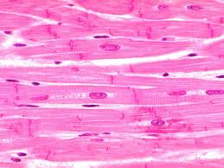
Name this muscle type:
Notes:
Cardiac muscle

Slide 6
Name this muscle type:
Notes:
Skeletal muscle

Slide 7
Muscle Organs – made up of muscle fibers and connective tissue
Connective tissue forms “wrappers” around each muscle fiber, around fascicles (groups) of muscle fibers, and around the entire muscle; fascia surrounds muscle organs and nearby structures.
Most skeletal muscles extend from one bone across a joint to another bone

Slide 8
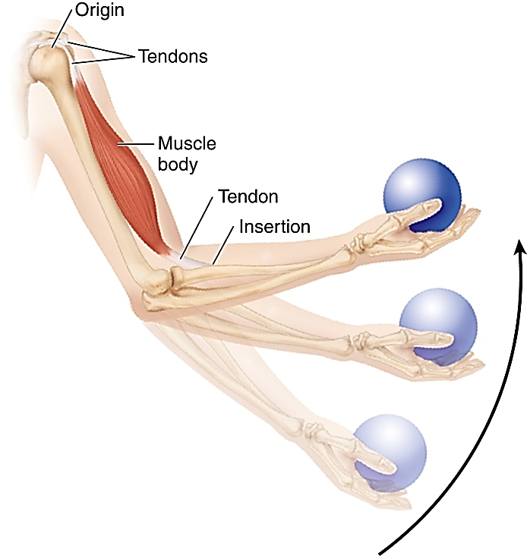
Regions of Skeletal Muscle
Figure 8-2
Origin: Attachment to the bone that remains relatively stationary or fixed when movement at the joint occurs
Insertion: Point of attachment to the bone that moves when a muscle contracts
Body: Main part of the muscle
Muscles attach to bone by tendons
Strong cords or sheets of fibrous connective tissue that extend from the muscle organ
Some tendons enclosed in synovial-lined tubes (tendon sheaths) and are lubricated by synovial fluid
Bursae - Small synovial-lined sacs containing a small amount of synovial fluid; located between some tendons and underlying bones

Slide 9
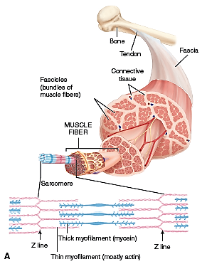
Muscle Fibers
Structure of muscle fibers (Figure 8-3) and contraction of muscle fibers
Contractile cells are called muscle fibers; connective tissue holds muscle fibers in parallel groupings
Fibers of the cytoskeleton form cylinders that contain thick myofilaments (containing myosin) and thin myofilaments (containing mainly actin)
Basic functional (contractile) unit called sarcomere
Sarcomeres separated from each other by dark bands called Z lines
Sliding filament model explains mechanism of contraction
Thick and thin myofilaments slide past each other to contract
Contraction requires calcium and energy-rich adenosine triphosphate (ATP) molecules (Figure 8-4)

Slide 10
Contraction of Muscle Fibers
Sliding filament model: thick and thin myofilaments in a muscle fiber first attach to one another by forming cross-bridges that then act as levers to pull the myofilaments past each other.
Calcium must be present!
This process requires energy in the form of ATP.
Requires Oxygen that is contained in muscle myoglobin (similar to RBC hemoglobin)

Slide 11
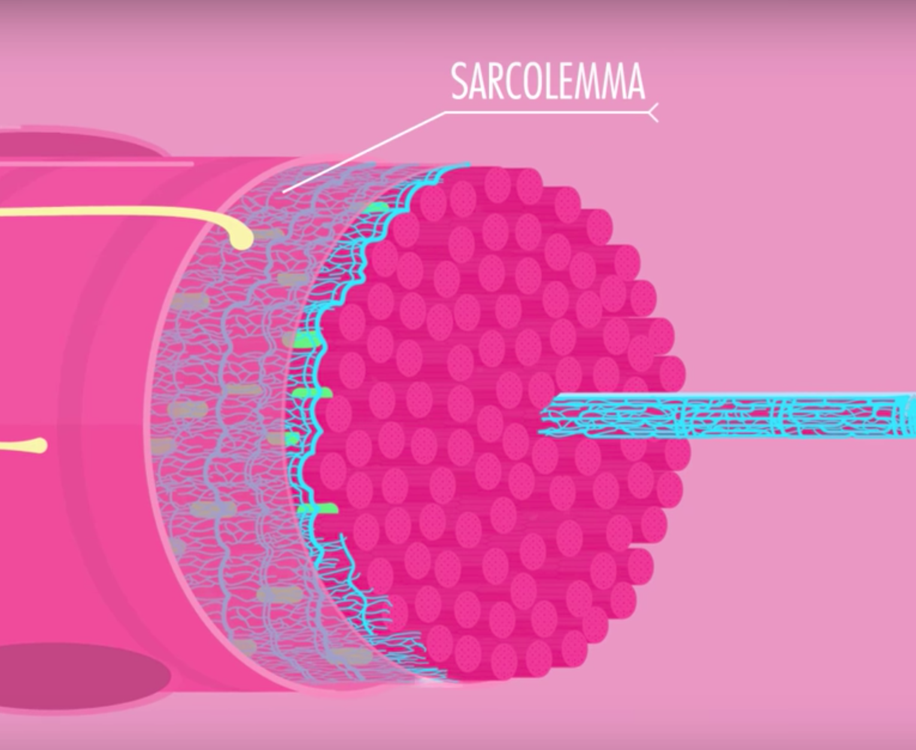
Nerve Impulse travels to a muscle fiber through a motor neuron.

Slide 12
Impulse triggers the release of Ca+ ions.
Notes:
Ca+ travels from smooth endoplasmic reticulum into the cytoplasm.

Slide 13
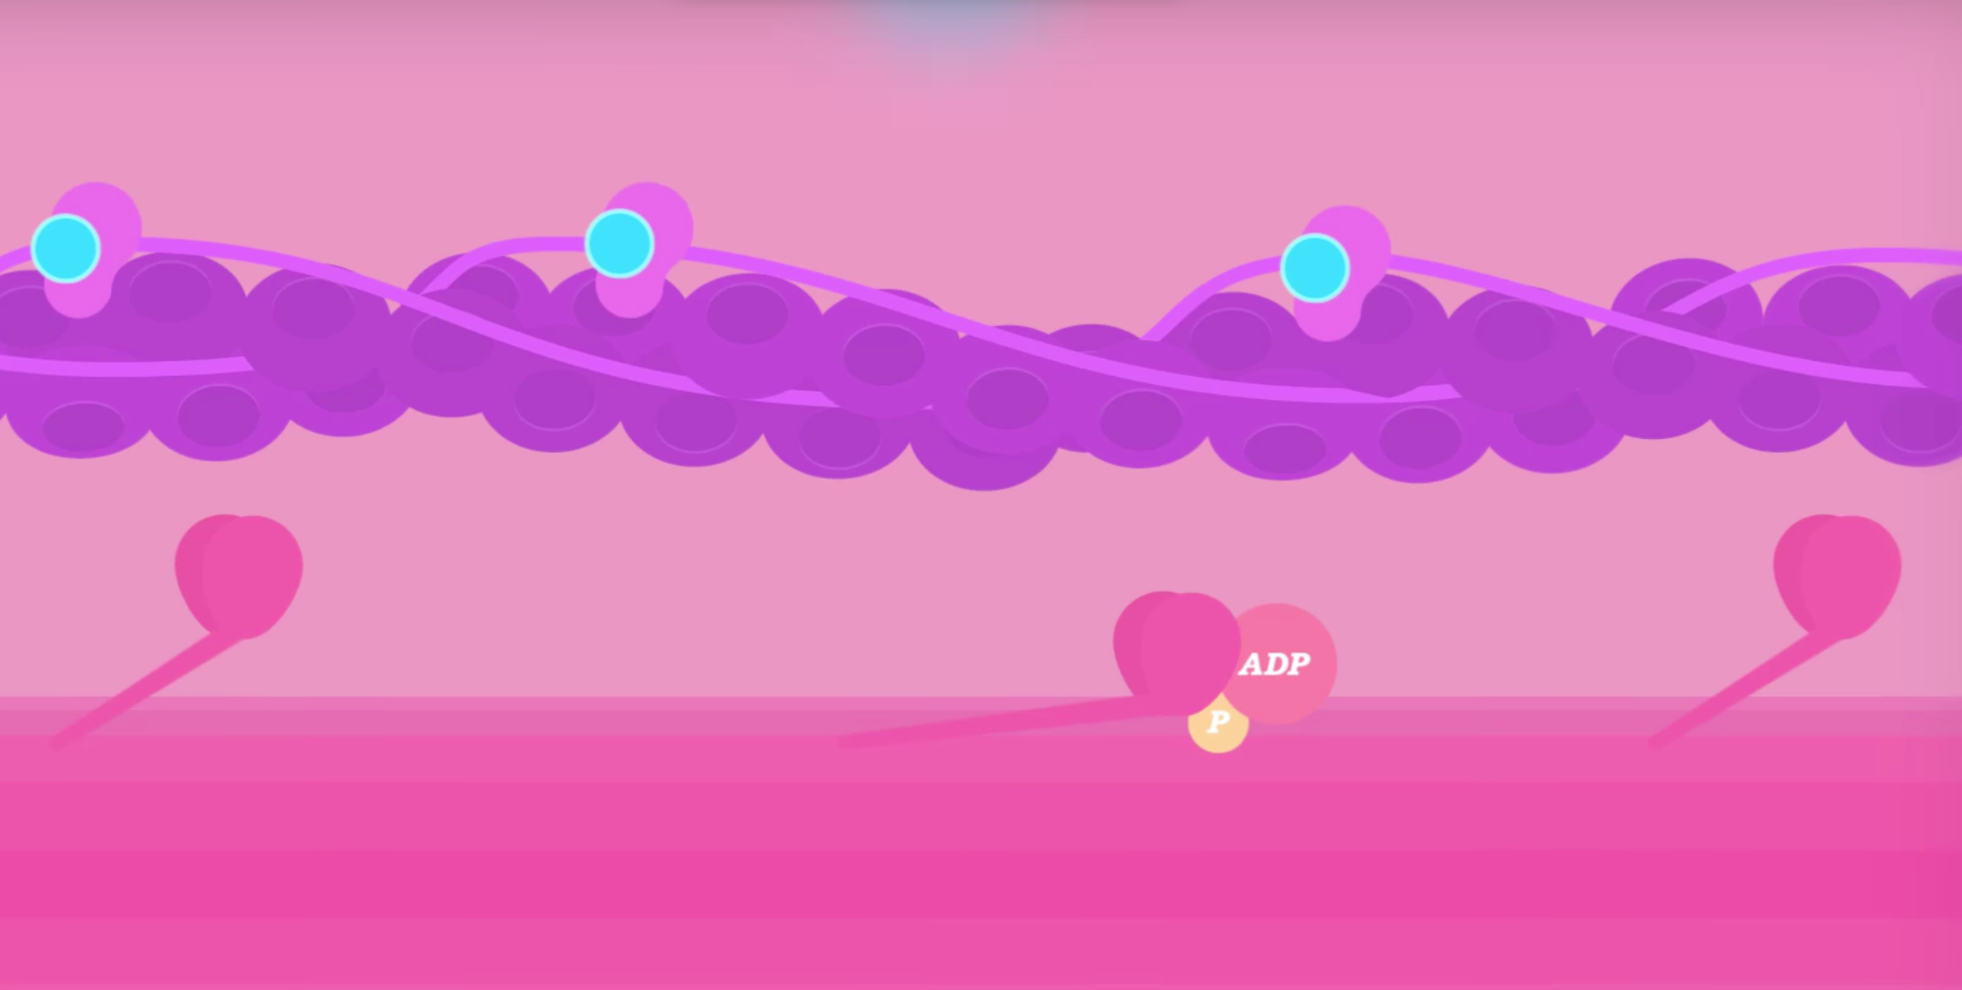
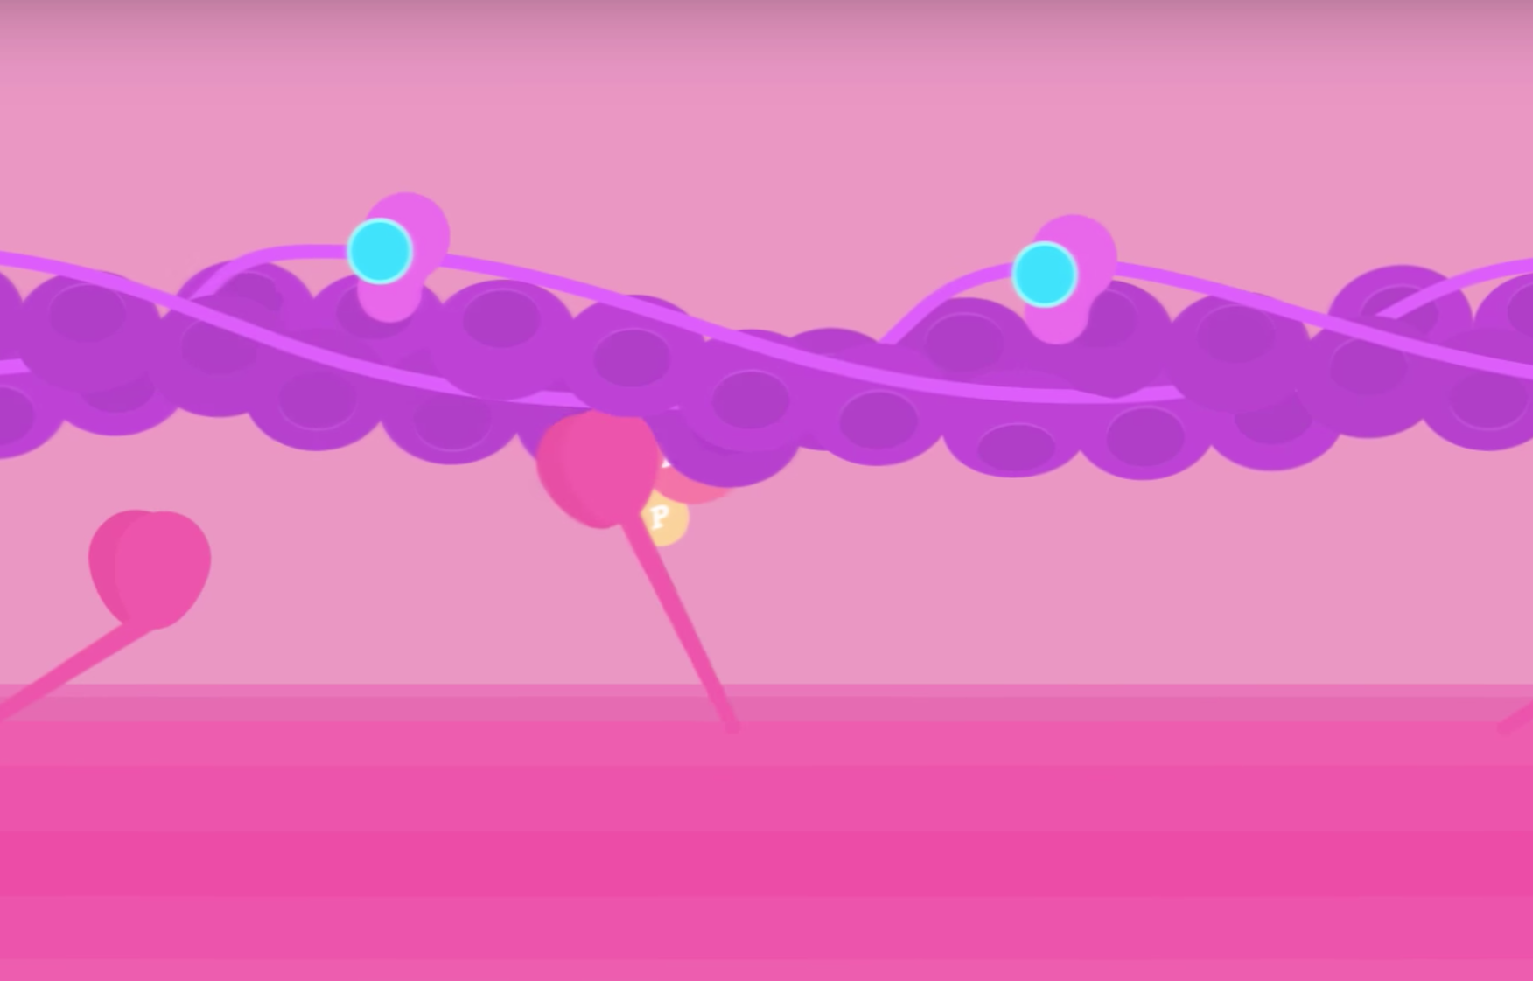
Ca+ bind to thin filaments
This permits actin to bind with myosin! (LOVE)
Myosin heads form cross-bridges with actin, pulling thin filaments to the middle of the sarcomere.

Slide 14
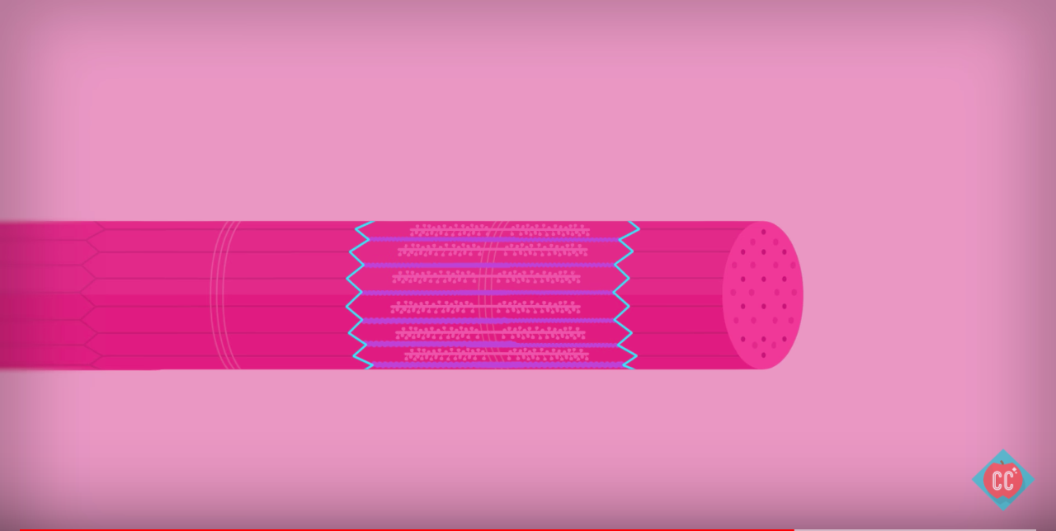
Sarcomere shortening = CONTRACTION!

Slide 15
Functions of a Skeletal Muscle
Movement
Posture
Heat Production
Fatigue

Slide 16
Functions of Skeletal Muscle - Movement
Muscles produce movement by pulling on bones as a muscle contracts
The insertion bone is pulled closer to the origin bone
Movement occurs at the joint between the origin and the insertion
Groups of muscles usually contract to produce a single movement
Prime mover: Mainly responsible for producing a given movement
Synergist muscles: Help the prime mover produce a given movement
Antagonist muscles: Oppose the action of a prime mover in a given movement

Slide 17
Posture
We are able to maintain our body position because of a continuous, low-strength muscle contraction called muscle tone or tonic contraction.
Great posture is positions that balance the distribution of weight and therefore put the least strain on muscles, tendons, ligaments, and bones.
Our head and trunk muscles constantly counteract the force of gravity to hold our head and trunk up.

Slide 18
Heat Production
Healthy survival depends on our ability to maintain a constant body temperature.
The contraction of muscle fibers produces most of the heat required to maintain body temperature.
ATP released during the sliding filament model is used to shorten muscle fibers but also is lost as heat, maintaining our body temp at a constant level.

Slide 19
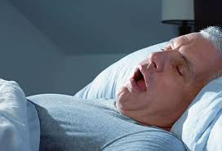
Fatigue
If muscle fibers are overstimulated without periods of rest, this results in fatigue.
The muscle loses its ability to contract
Oxygen debt: used to describe the metabolic effort required to burn excess lactic acid that may accumulate during prolonged periods of exercise.
Labored breathing after strenuous exercise is required to “pay the debt”.
This increased metabolism helps restore energy and oxygen reserves to pre-exercise levels.
Formation of more ATP when ATP is depleted results in a rapid consumption of oxygen and nutrients.

Slide 20
Role of Other Body Systems in Movement
Muscle functioning depends on the functioning of many other parts of the body
Most muscles cause movements by pulling on bones across moveable joints
Respiratory, circulatory, nervous, muscular, and skeletal systems play essential roles in producing normal movements
Multiple sclerosis, brain hemorrhage, and spinal cord injury are examples of how pathological conditions in other body organ systems can dramatically affect movement

Slide 21
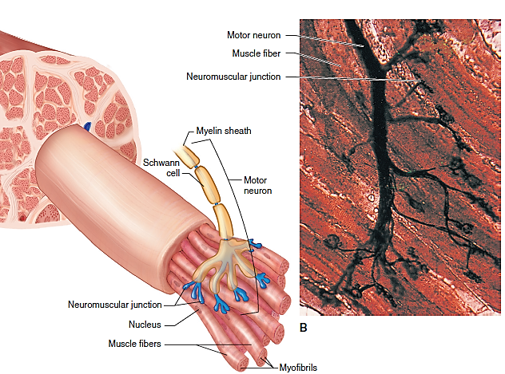
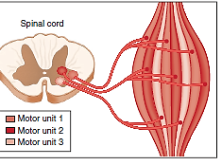
Motor Unit
Muscle fibers are stimulated by a nerve fiber called a motor neuron
The point of contact between the nerve ending and the muscle fiber is called a neuromuscular junction
Neurotransmitters are released by the motor neuron in response to a nervous impulse.
The type of neurotransmitter operating in each NMF is called acetylcholine (Ach).
The released ACH moves across the NMJ and triggers events within the muscle fiber that result in contraction or shortening of the muscle fiber.
A single motor neuron, with the muscle fibers it innervates is called a motor unit

Slide 22
Muscle Stimulus
A muscle will contract only if an applied stimulus reaches a certain level of intensity
Threshold stimulus: Minimal level of stimulation required to cause a muscle fiber to contract
Once stimulated by a threshold stimulus, a muscle fiber will contract completely, a response called “all or none”
When a muscle fiber is subjected to a threshold stimulus, the muscle fiber contracts completely. NOT THE WHOLE MUSCLE.
Different muscle fibers in a muscle are controlled by different motor units.
Notes:
Although individual muscle fibers always respond “all or none” to a threshold stimulus, the muscle as a whole does not
Different motor units responding to different threshold stimuli permit a muscle as a whole to execute contractions of graded force

Slide 23
Types of Skeletal Muscle Contraction
Twitch and Tetanic
Twitch is a quick, jerky response to a stimulus. Think weightlifting! Fast movements.
Tetanic contraction is more sustained and steady response than twitch.
Isotonic and Isometric
Isotonic contraction produces movement at a joint, muscle changes length and insertion end moves towards origin.
Eccentric and concentric
Isometric contraction that does not produce movement.
Notes:
Concentric contraction: The muscle shortens at the insertion end of the muscle to move toward the point of origin
Eccentric contraction: The muscle lengthens under tension, thus moving the insertion away from the origin

Slide 24
Isotonic and Isometric

Slide 25
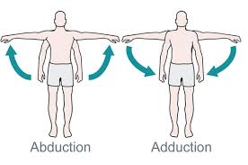
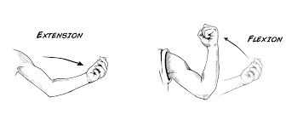
Movements Produced by Muscle Contractions
Abduction vs. Adduction
Plantarflexion vs. Dorsiflexion
Flexion vs. Extension

Slide 26
Exercise and Skeletal Muscle
Exercise, if regular and properly practiced, improves muscle tone and posture, results in more efficient heart and lung functioning, and reduces fatigue.
During prolonged inactivity, muscles usually shrink in mass, a condition called disuse atrophy.
Exercise on the other hand, may cause an increase in muscle size called hypertrophy.

Slide 27
Effects of Exercise on Skeletal Muscle
Strength training is exercise involving contraction of muscles against heavy resistance
Strength training increases the number of myofilaments in each muscle fiber, and as a result, the total mass of the muscle increases
Strength training does not increase the number of muscle fibers
Endurance training is exercise that increases a muscle’s ability to sustain moderate exercise over a long period; it is sometimes called aerobic training
Endurance training allows more efficient delivery of oxygen and nutrients to a muscle via increased blood flow
Endurance training does not usually result in muscle hypertrophy

Slide 28
Movements Produced by Skeletal Muscle Contractions
Angular movements
Flexion: Decreases an angle
Extension: Increases an angle
Abduction: Away from the midline
Adduction: Toward the midline
Circular movements
Rotation: Around an axis
Circumduction: Move distal end of a part in a circle
Supination and pronation: Hand positions that result from twisting the forearm
Special movements
Dorsiflexion and plantar flexion: Ankle movements (upward and downward foot movement)
Inversion and eversion: Ankle movements (sideways)

Slide 31
Skeletal Muscle Groups
Muscles of the head and neck
Facial muscles
Orbicularis oculi
Orbicularis oris
Zygomaticus
Muscles of mastication
Masseter
Temporal
Sternocleidomastoid: Flexes head
Trapezius: Elevates shoulders and extends head

Slide 32
Muscles of Head and Neck

Slide 33
Skeletal Muscle Groups
Muscles that move the upper extremities
Muscles that move the lower extremities
Pectoralis major: Flexes arm
Latissimus dorsi: Extends arm
Deltoid: Abducts arm
Biceps brachii: Flexes forearm
Triceps brachii: Extends forearm
Iliopsoas: Flexes thigh
Gluteus maximus: Extends thigh
Adductor muscles: Adduct thighs
Hamstring muscles: Flex leg
Semimembranosus
Semitendinosus
Biceps femoris
Quadriceps femoris group: Extend lower leg
Rectus femoris
Vastus muscles
Tibialis anterior: Dorsiflexes foot
Gastrocnemius: Plantar flexes foot
Peroneus group: Flex foot

Slide 34
Muscles of the Trunk
Abdominal muscles
Rectus abdominis
External oblique
Internal oblique
Transversus abdominis
Respiratory muscles
Intercostal muscles
Diaphragm

