Slide 1
Chapter 12 - Blood
AP130 North-West College
Ms. Escoto

Slide 2
Blood Composition
Blood tissue – our blood is considered a “fluid tissue”. This includes our plasma, buffy coat, and formed elements.
Blood plasma – basically just the blood minus its cells.
Composition
Water containing many dissolved substances (e.g., nutrients, salts, and hormones)
Amount of blood
Varies with size and sex
4 to 6 L about average
About 7% to 9% of body weight

Slide 3
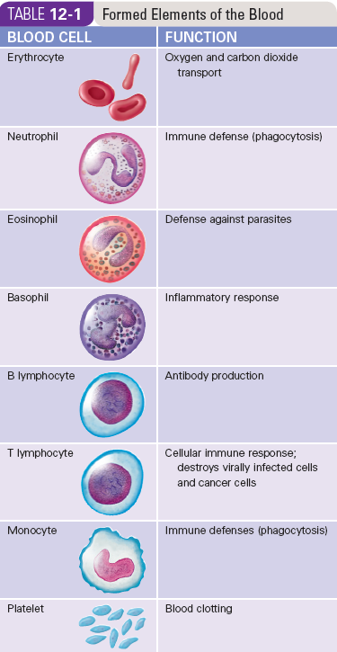
Formed Elements of the Blood
Erythrocytes – RBCs
Neutrophils, Eosinophils, Basophils – Immune and Inflammation
B and T Lymphocytes – antibody production and cell destruction
Monocyte – phagocytosis
Platelets – blood clots

Slide 4
Formed Elements
Types include:
RBCs
WBCs
Granular leukocytes: neutrophils, eosinophils, and basophils
Agranular leukocytes: Lymphocytes and monocytes
Platelets, or thrombocytes
Counts of:
RBCs: 4.2 to 6.2 million per mm³ of blood
WBCs: 5000 to 10,000 per mm³ of blood
Platelets: 300,000 per mm³ of blood

Slide 5
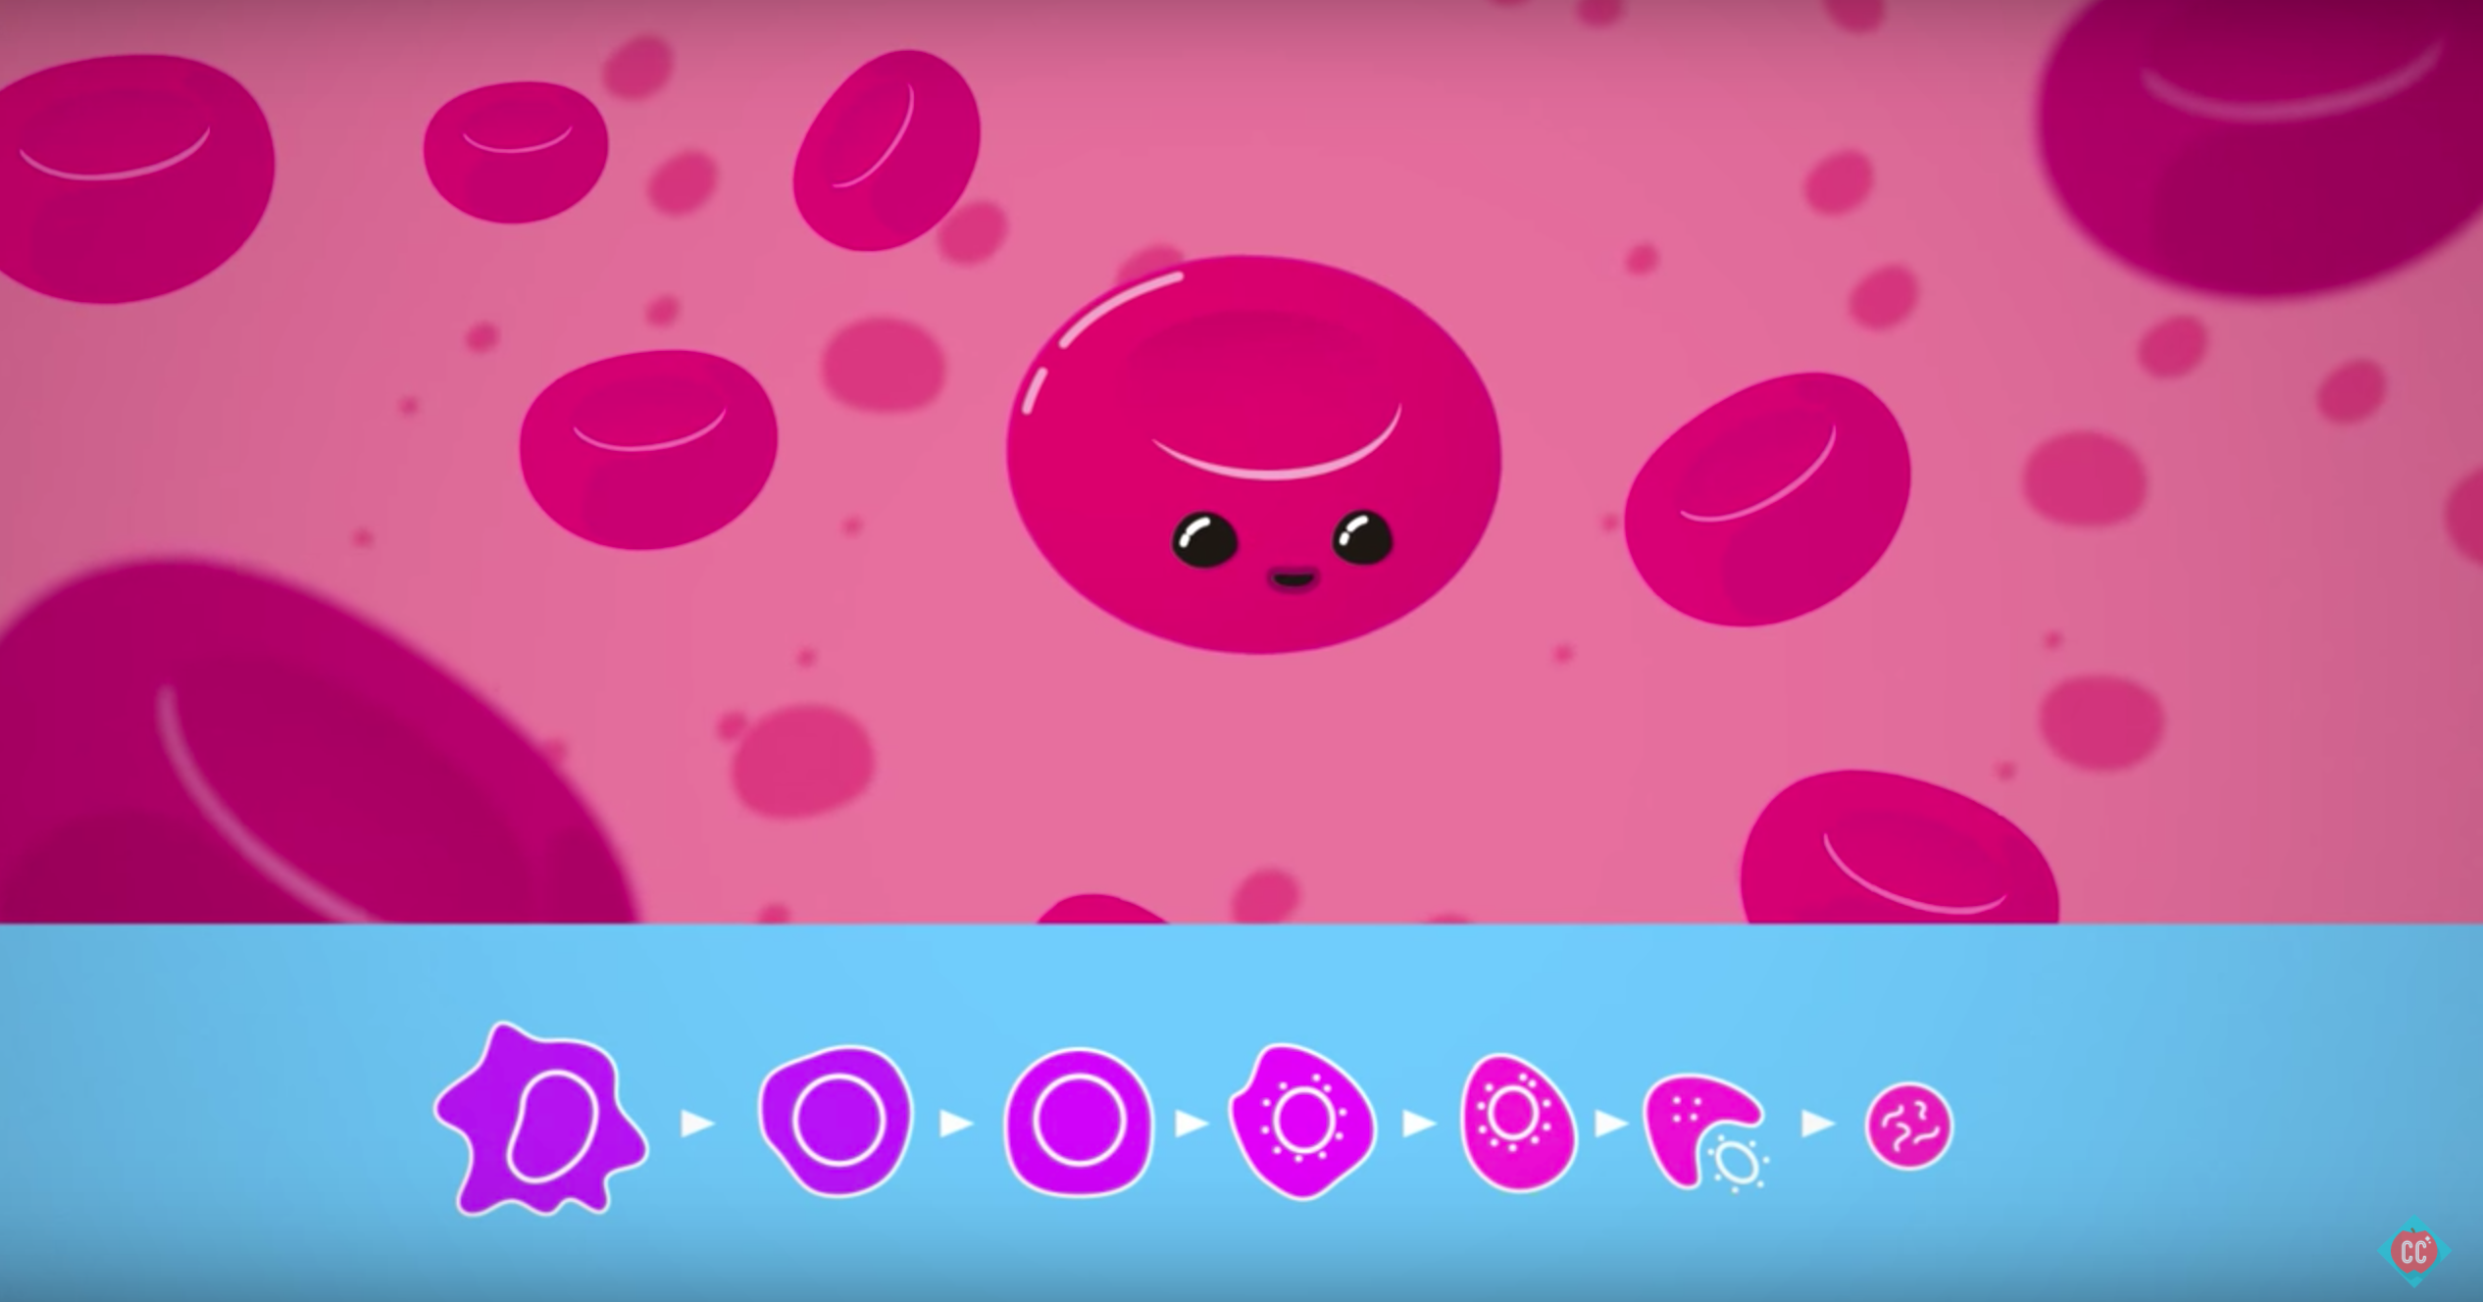
Hematopoiesis
Formation of new blood cells made by two types of connective tissue:
Myeloid tissue (Red bone marrow)
Lymphoid tissue (lymph tissue in lymph nodes, thymus, and spleen)

Slide 6
Components of Blood

Slide 7
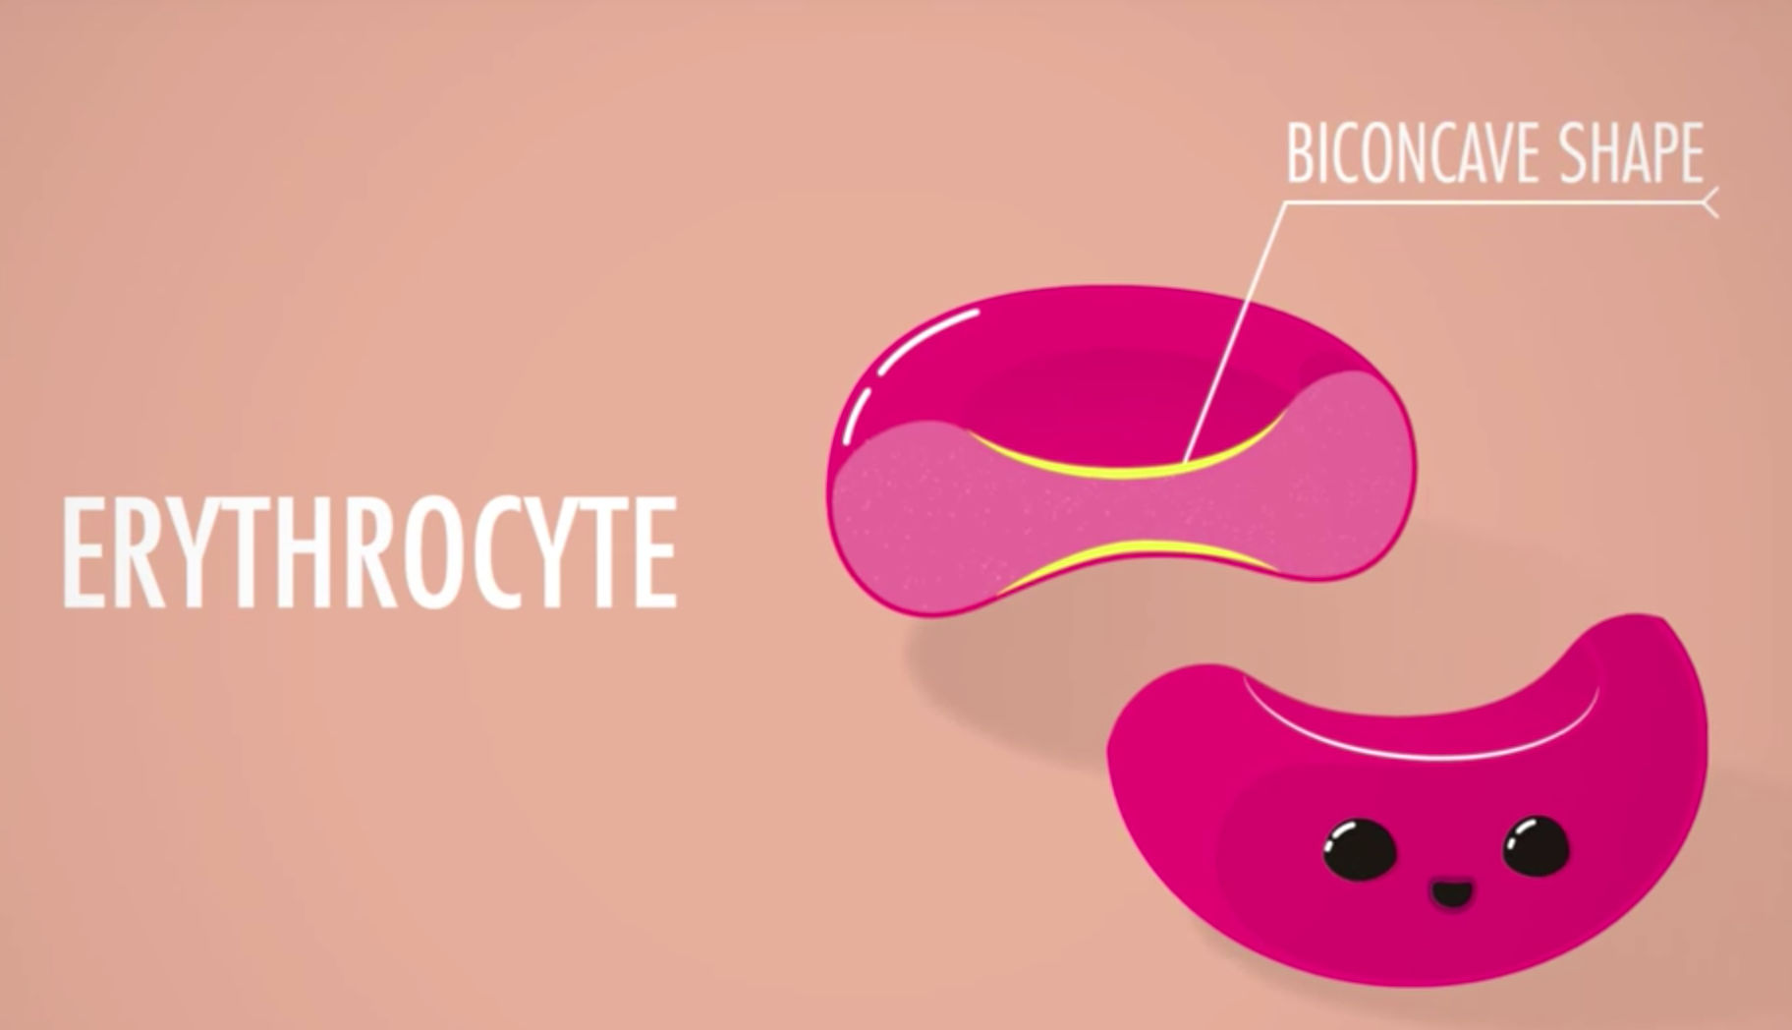
Red Blood Cells
RBC structure and function:
Structure – Disk-shaped, no nuclei or organelles.
Function – To transport oxygen and carbon dioxide throughout the body.
Because mature RBCs have no nucleus or organelles, they are unable to reproduce themselves or replace lost or damaged cellular components.

Slide 8
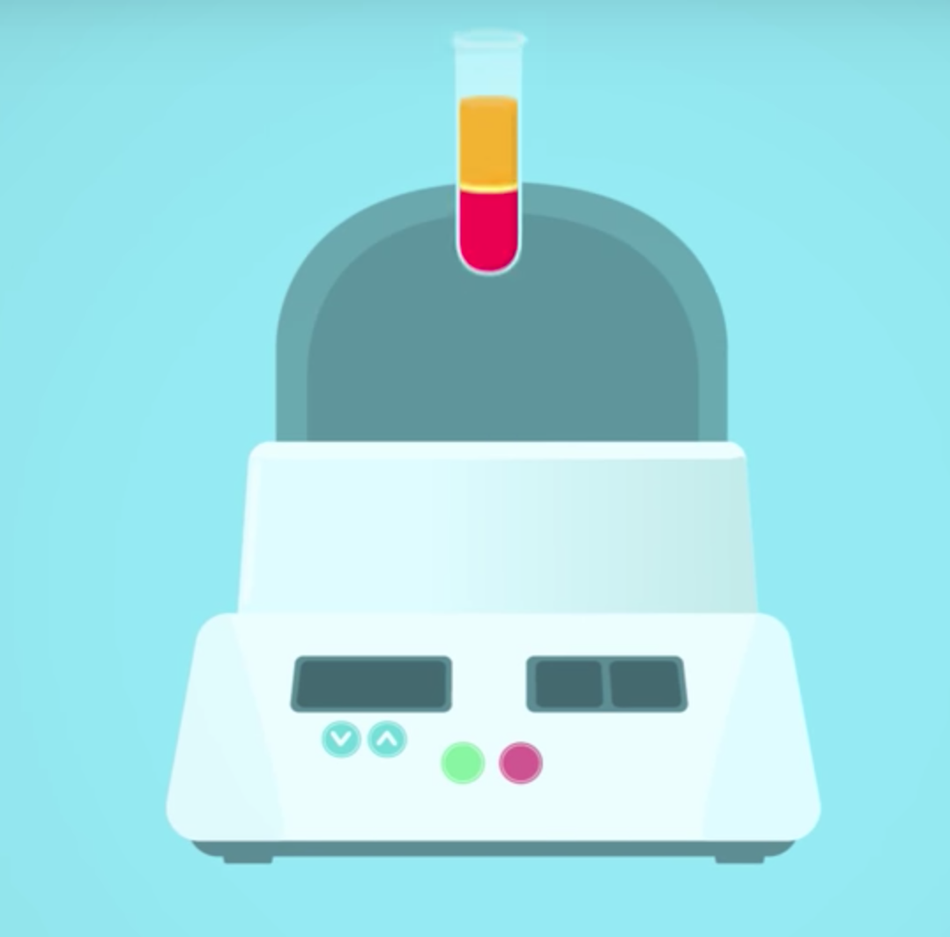
RBC Count
Complete blood cell count (CBC) – battery of tests used to measure amounts or levels of many blood constituents.
Hematocrit (Hct) test – Medical test in which a centrifuge is used to separate whole blood into formed elements and liquid fraction. Gives an estimate of the proportion of RBCs to whole blood.
Buffy coat is WBC and platelet fraction
Normal RBC amount is about 45% of whole blood
This test can result in errors in readings when patient is dehydrated.

Slide 12
Hematocrit Test Readings

Slide 13
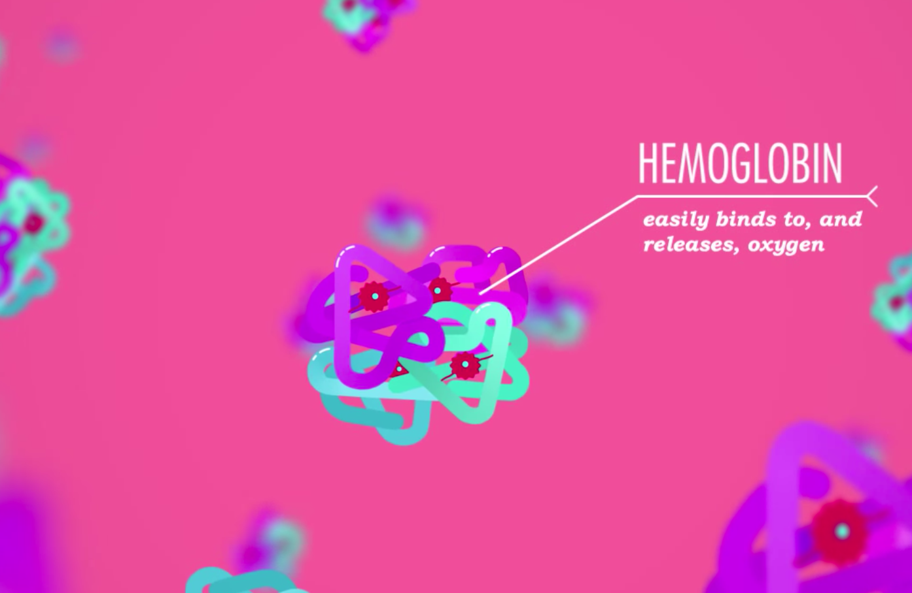
Red Blood Cells
Hemoglobin – fill the millions of RBCs in our blood and are critical in the transport of oxygen and carbon dioxide to the body’s cells and back out of the body.
Anemia – inability of blood to carry adequate oxygen to tissues. Caused by:
Inadequate RBC numbers
Deficiency of hemoglobin
Pernicious anemia: Deficiency of Vitamin B12.

Slide 14
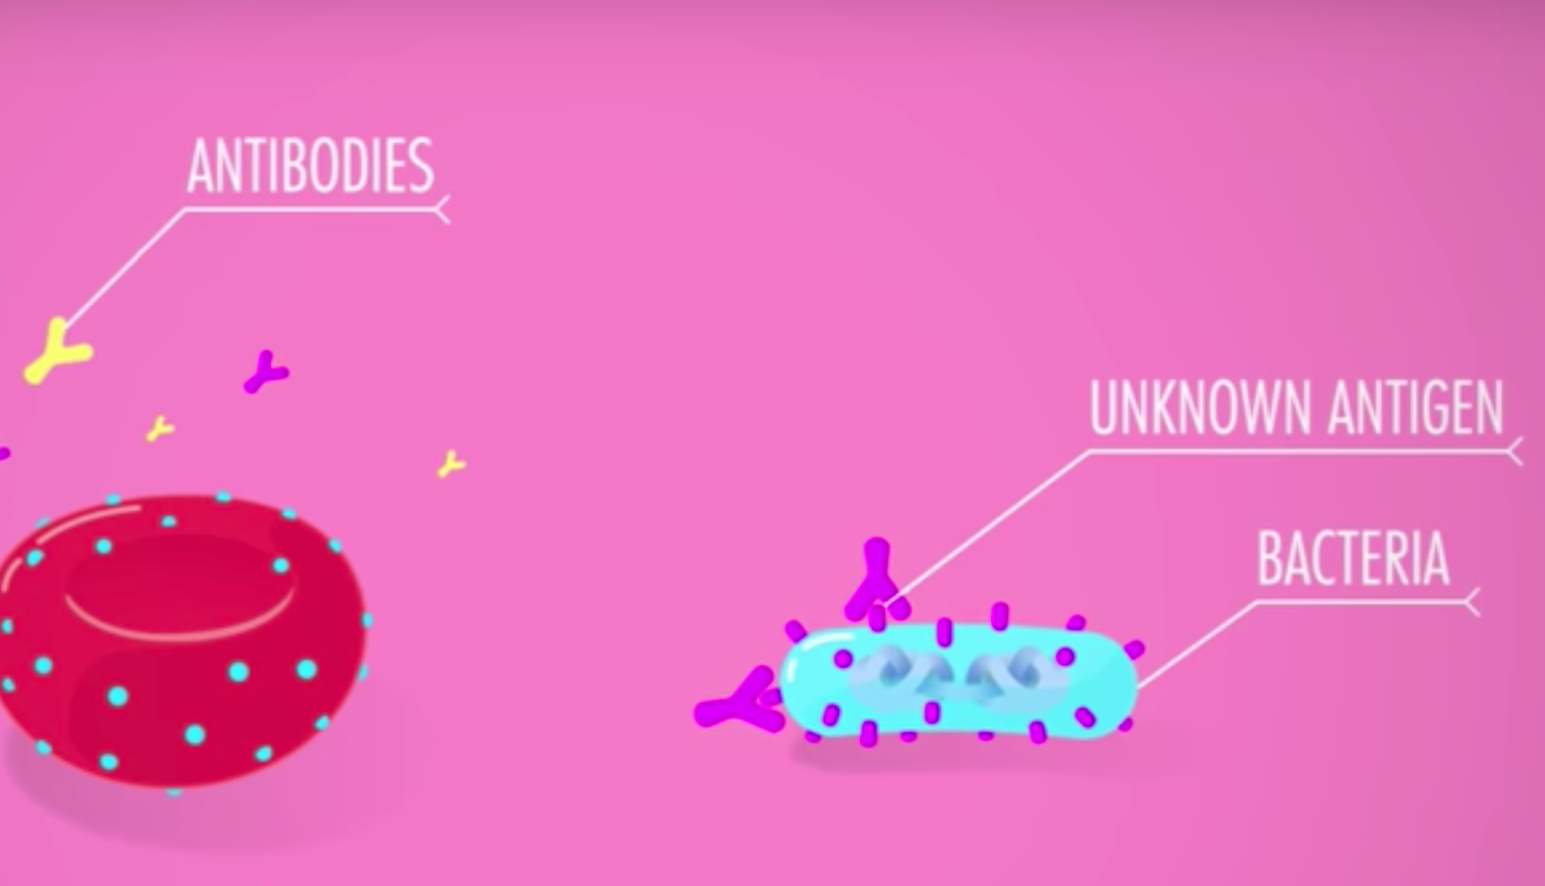
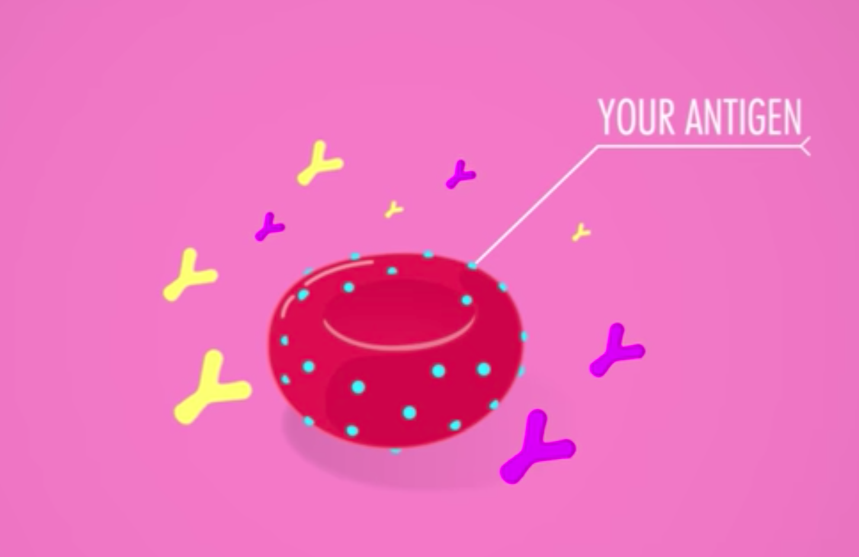
Blood Types
Antigen – substance that surrounds every cell and, if recognized as a threat, can activate immune system.
Antibody – substance made by body in response to stimulation by an antigen.
Many antibodies react with their antigens to cause clumping or “agglutination”.

Slide 15
Blood types: ABO system
Type A
Type A self-antigens in RBCs; anti-B type antibodies in plasma
Type B
Type B self-antigens in RBCs; anti-A type antibodies in plasma
Type AB
Type A and type B self-antigens in RBCs; no anti-A or anti-B antibodies in plasma
Type O
No type A or type B self-antigens in RBCs; both anti-A and anti-B antibodies in plasma

Slide 17
Blood Typing

Slide 18
Rh System
Rh-Positive blood
Rh-negative blood
Rh factor antigen present in RBCs
No Rh factor present in RBCs
No anti-Rh antibodies present naturally in plasma
Anti-Rh antibodies, however, appear in plasma of Rh-negative persons if Rh-positive RBCs have been introduced into their bodies.

Slide 19
Universal Donor and Recipients
Type O Rh-negative: Universal donor blood
Type AB Rh-positive: Universal recipient blood
Hemolytic anemia called erythroblastosis fetalis – may occur when:
Rh-negative mother carries a second fetus
Rh-positive fetus; caused by mother’s Rh antibodies reacting with fetus’s Rh-positive cells
Blood types: Combined ABO-Rh system
Both ABO and Rh systems are often used in combination to identify a person’s blood type.
Notes:
All Rh-negative mothers who carry an Rh-positive baby should be treated with an immunoglobulin (antibody) serum (RhoGAM).
Likewise, a person with Rh-negative blood who receives a transfusion of Rh-positive blood will also develop anti-Rh antibodies and be at risk of an immune reaction if exposed to Rh-positive blood again later.
Knowing one’s blood type can be lifesaving in a medical emergency or during surgery.

Slide 20
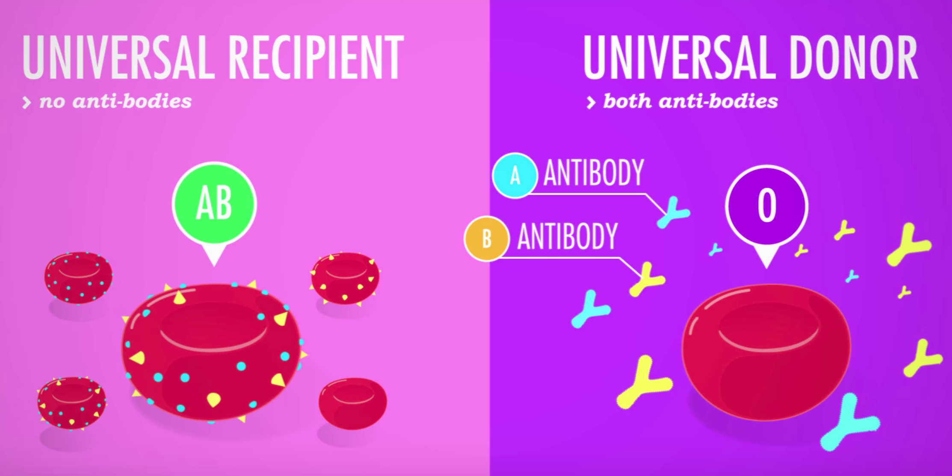
Universal Donors and Recipients

Slide 21
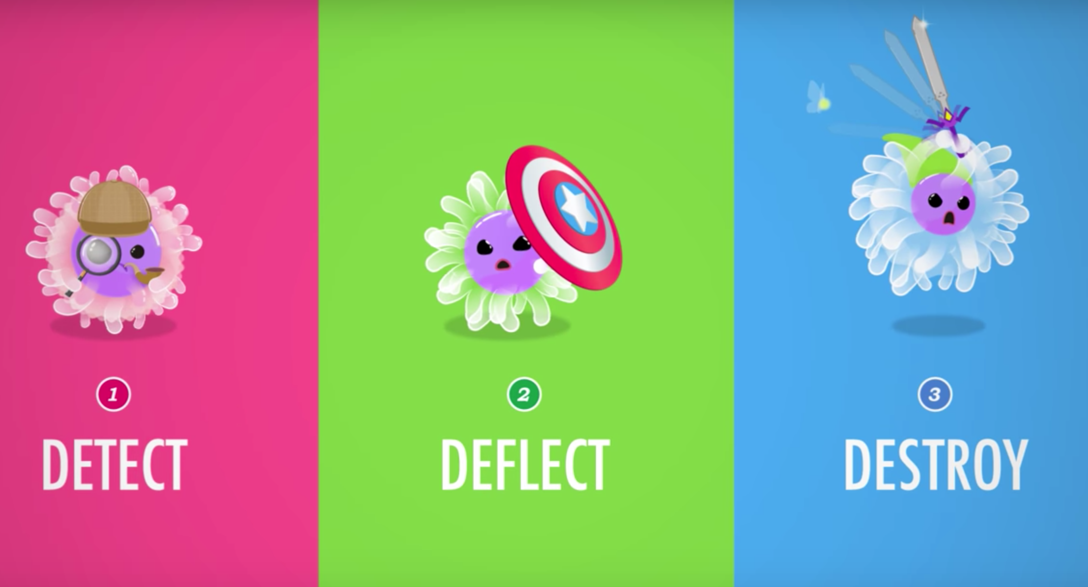
White Blood Cells
Introduction to WBCs
WBCs are also called leukocytes
General function: Defense
WBC count
Differential WBC count reveals proportions of each type of WBC
Leukopenia: Abnormally low WBC count
Leukocytosis: Abnormally high WBC count
Notes:
Different types of WBCs are categorized by the presence or absence of stained granules in their cytoplasm.
All of the WBCs are involved in immunity.

Slide 22
WBC Types
Granular Leukocytes
Agranular Leukocytes
Neutrophils and monocytes carry out phagocytosis
Eosinophils protect against parasitic irritants and allergies
Basophils produce heparin, which inhibits clotting
Lymphocytes produce antibodies (B-lymphocytes) or directly attack foreign cells (T-lymphocytes)

Slide 23
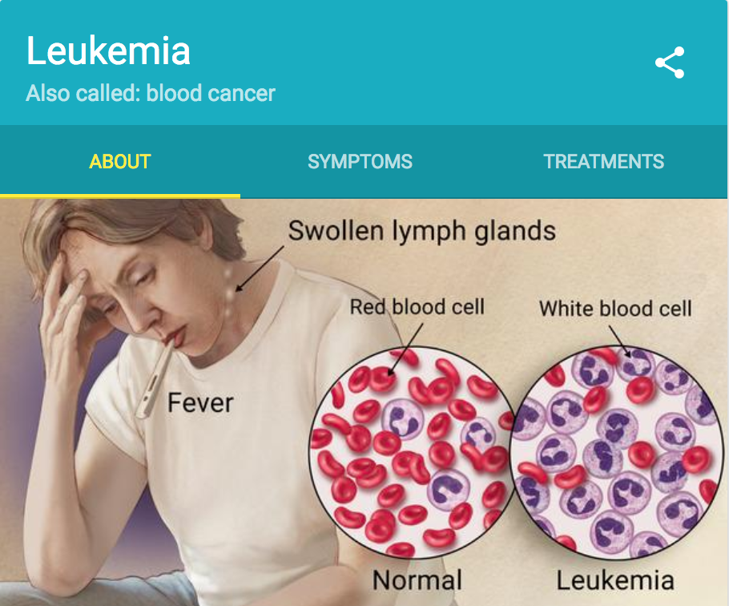
WBC disorders
Leukemia (cancer of the blood) is characterized by:
Elevated WBC count
Cells that do not function properly
Leukemia is the term used to describe a number of cancers affecting the WBCs.
Different types of leukemia are either “acute” or “chronic.”

Slide 24
Platelets and Blood Clotting
Platelets - Play an essential role in blood clotting by forming a “plug”
Blood clotting (Figure 12-10)
Clotting factors released at the injury site produce prothrombin activator
Prothrombin activator and calcium convert prothrombin to thrombin
Thrombin reacts with fibrinogen and triggers formation of fibrin, which traps RBCs to form a clot

Slide 26
Abnormal Blood Clots
Thrombus: When a clot stays in the place it has formed
Condition is called thrombosis
Embolus: When a part of a clot dislodges and circulates through the bloodstream
Condition is called embolism
Notes:
A number of drugs are now available to help dissolve abnormal clots.
Streptokinase and recombinant tissue plasminogen activator are drugs frequently used in a variety of conditions, including treatment of clot-induced strokes, heart attacks, and other thrombus-induced and embolus-induced medical emergencies.

