Slide 1
Chapter 13 – Cardiovascular System
A&P140 North-West College
Ms. Escoto

Slide 2
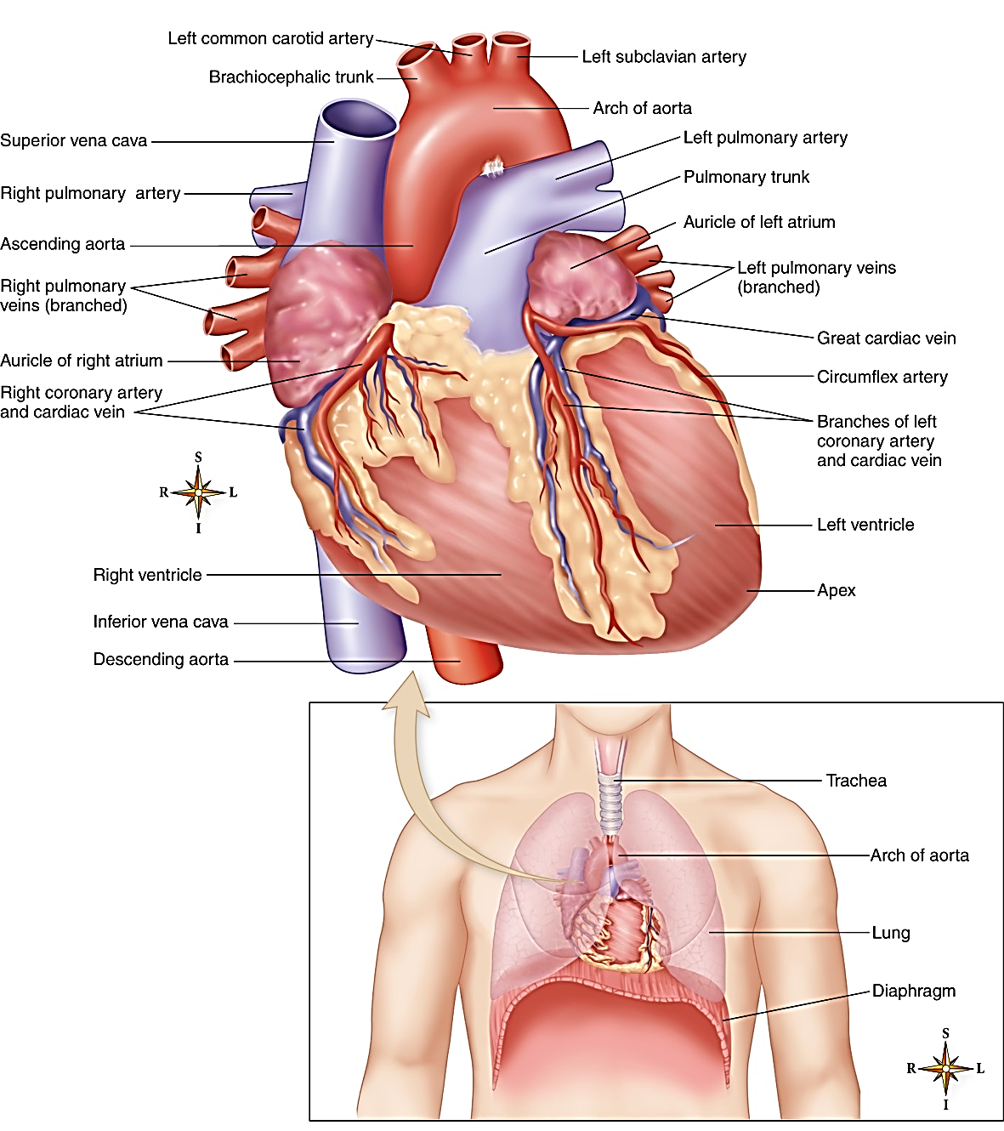
The Heart – everyone’s favorite muscle
This organ is located between the lungs in the lower portion of the mediastinum.
About the size of a closed fist.
For the purposes of CPR (Cardiopulmonary Resuscitation), the heart lies between the sternum anterior and the bodies of the thoracic vertebrae posterior. CPR involves rhythmic compression of the heart that can maintain blood flow.
Combined with artificial respiration, it can save lives.

Slide 3
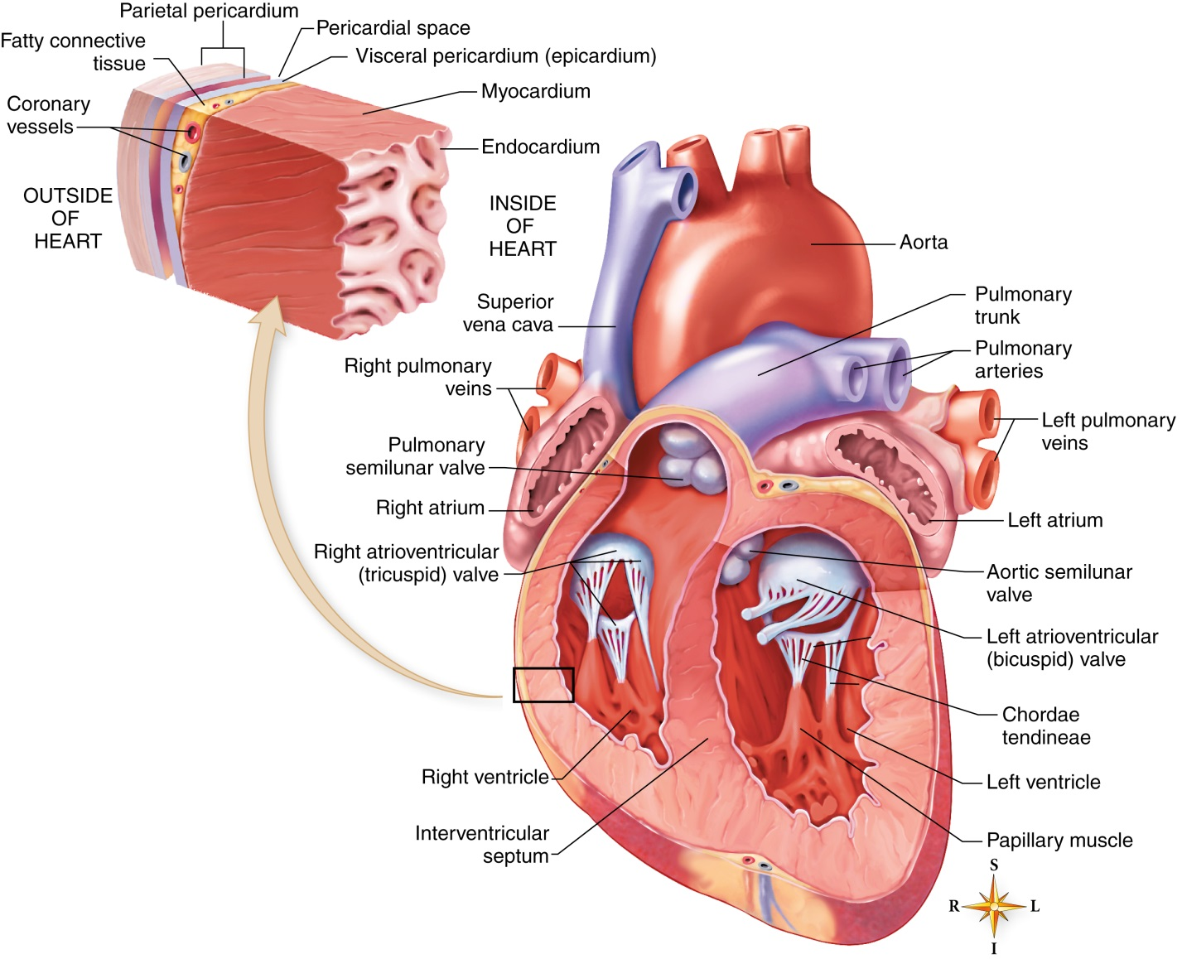
Heart – Functional Anatomy
Heart Chambers include:
2 upper chambers called the atria. (Right and Left Atrium)
Two lower chambers called ventricles (Right and Left Ventricles)
The wall of each heart chamber is composed of cardiac muscle tissue called myocardium, which is responsible for the motion of pumping.
Endocardium is the smooth lining of the heart chambers.
Pericardium - A two-layered fibrous sac with a lubricated space between the two layers
Inner layer called visceral pericardium or epicardium
Outer layer called parietal pericardium
Notes:
Myocardial tissue is greater in ventricles than in the atria.
Inflammation of endocardium called endocarditis

Slide 4
Heart – More Functional Anatomy
Heart action
Contraction of the heart is called systole
Relaxation is called diastole
The heart action is powered by the heart valves which close and open to channel blood through the chambers of the heart.
Valves are designed to keep blood flowing through the heart and prevent backflow
Consists of 2 atrioventricular (AV) and two semilunar (SL) valves
Left AV – bicuspid (mitral): At opening of the left atrium into the ventricle
Right AV – tricuspid: At opening of the right atrium into the ventricle
Pulmonary SL: At beginning of the pulmonary artery
Aortic SL: At beginning of the aorta
Notes:
1 – right atria
2 – right ventricle
3 – left atria
4 – left ventricle
5 – pulmonary vein
6 – aorta
7 – superior vena cava
8 – inferior vena cava
9 – pulmonary artery

Slide 5
Heart Action

Slide 6
Heart Sounds
Heart sounds
Two distinct heart sounds in every heartbeat or cycle: Described as lub dup
First sound (lub) is caused by the vibration and closure of AV valves during contraction of the ventricles
Second sound (dup) is caused by the closure of the semilunar valves during relaxation of the ventricles

Slide 7
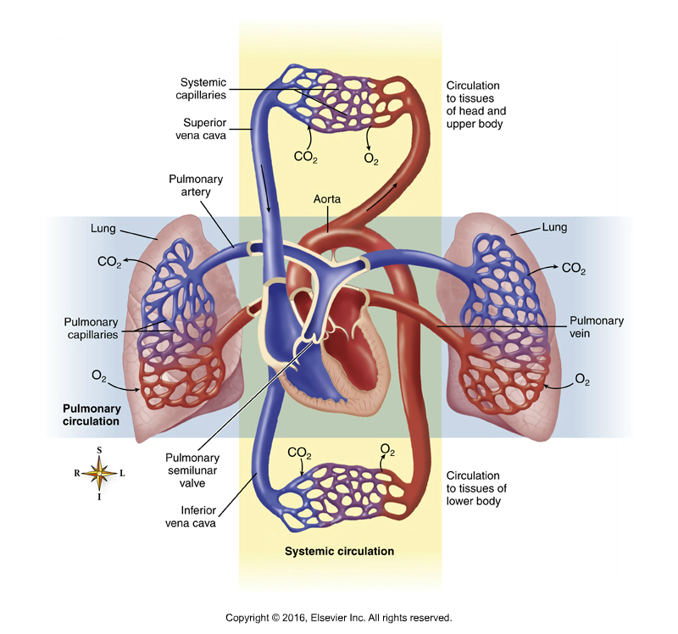
Blood Flow through Heart
Blood flow through the heart (Figure 13-4)
The heart acts as two separate pumps: Right atrium and ventricle performing different functions from the left atrium and ventricle
Sequence of flow
Venous blood enters the right atrium through the superior and inferior venae cavae
Passes from the right atrium through the tricuspid valve to the right ventricle
From the right ventricle it passes through the pulmonary semilunar valve to the pulmonary artery to the lungs
Blood moves from the lungs to the left atrium, passing through the bicuspid (mitral) valve to the left ventricle
Blood in the left ventricle is pumped through the aortic semilunar valve into the aorta and is distributed to the body as a whole
Notes:
Figure 13-3, A: During atrial systole (contraction), cardiac muscle in the atrial wall contracts, forcing blood through the atrioventricular (AV) valves and into the ventricles.
Figure 13-3, B: During ventricular systole that follows, the AV valves close, the blood is forced out of the ventricles through the semilunar (SL) valves and into the arteries.

Slide 8
The Heart’s Blood Supply
The heart needs blood flow to contract its muscles too! Even though it’s constantly pumping blood, the blood it’s pumping is not transferring its nutrients directly to the heart during contraction.
Where do they get their blood supply from? Coronary arteries!
Blood, which supplies oxygen and nutrients to the myocardium of the heart, flows through the right and left coronary arteries (Figure 13-5); called coronary circulation
Blockage of blood flow through the coronary arteries is called myocardial infarction (MI; heart attack)
Angina pectoris: Chest pain caused by inadequate oxygen to the heart
Coronary bypass surgery: Veins from other parts of the body are used to bypass blockages in coronary arteries

Slide 9
Cardiac Cycle
Cardiac cycle
Heartbeat is regular and rhythmic: Each complete beat is called a cardiac cycle; average is about 72 beats per minute
Each cycle, about 0.8 second long, is subdivided into systole (contraction phase) and diastole (relaxation phase)
Stroke volume: Volume of blood ejected from one ventricle with each beat
Cardiac output: Amount of blood that one ventricle can pump each minute; average is about 5 L per minute at rest
Averages about 5 L in a normal, resting adult
Determined by the heart rate and stroke volume
Notes:
Heart rate refers to the number of heart beats (cardiac cycles) per minute.
Stroke volume refers to the volume of blood ejected from the ventricles during each beat.

Slide 10
Electrical Activity of the Heart
How does the heart actually pump?
It needs a nervous stimulation to the muscles in the form of an electrical conduction system.
Conduction System (Figure 13-9)
Intercalated disks are electrical connectors that join all the cardiac muscle fibers in a region together so that they receive their impulse, and thus contract, at about the same time.
Specialized conduction system structures generate and transmit the electrical impulses that result in contraction of the heart.
Sinoatrial (SA) node, the pacemaker: Located in the wall of the right atrium near the opening of the superior vena cava
Atrioventricular (AV) node: Located in the right atrium along the lower part of the interatrial septum
AV bundle (bundle of His): Located in the septum of the ventricle
Purkinje fibers: Located in the walls of the ventricles

Slide 11
Conduction System of the Heart

Slide 12
Electrical Activity of the Heart (cont.)
Electrocardiogram (Figure 13-10)
The tiny electrical impulses traveling through the heart's conduction system can be picked up on the surface of the body and transformed into visible tracings by a machine called an electrocardiograph
The visible tracing of these electrical signals is called an electrocardiogram, or ECG
The normal ECG has three deflections or waves
P wave: Associated with depolarization of the atria
QRS complex: Associated with depolarization of the ventricles
T wave: Associated with repolarization of the ventricles

Slide 13
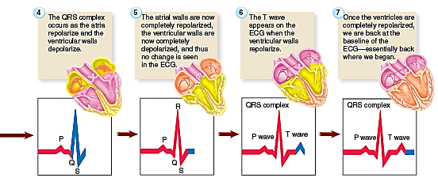
Electrocardiogram (ECG)

Slide 14
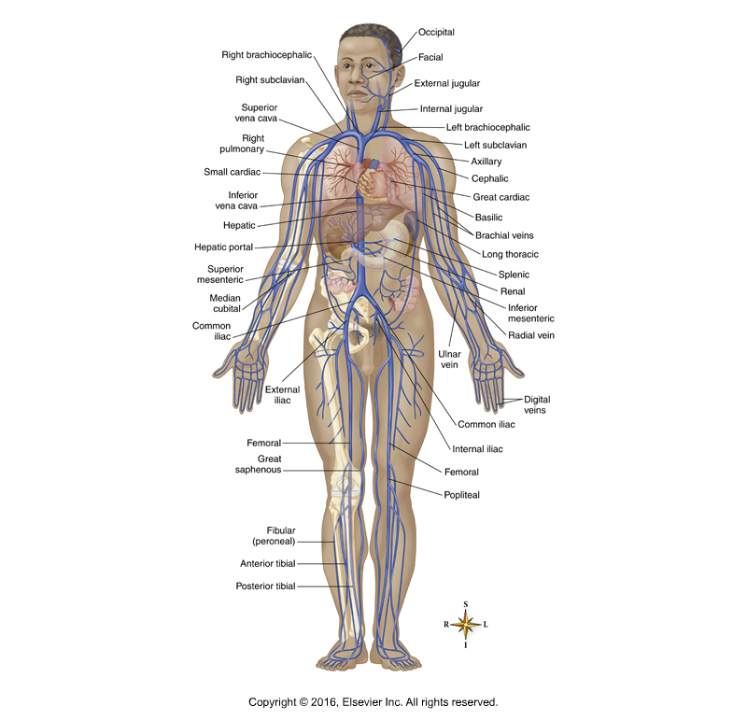
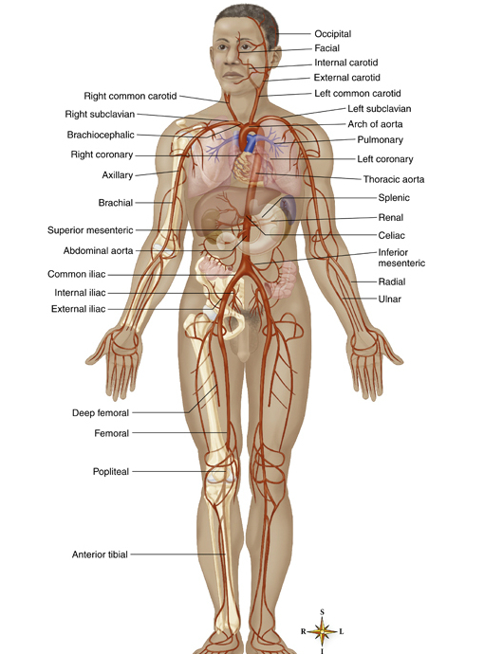
Blood Vessels
Arteries – Carry blood away from the heart and towards capillaries
Veins – Carry blood toward the heart and away from capillaries
Capillaries – Carry blood from the arterioles to the venules
Notes:
Arterial blood is pumped from the heart through a series of large distribution vessels (arteries).
Aorta is largest artery in the body.
Sinuses (superior vena cava and inferior vena cava) are largest veins.

Slide 15
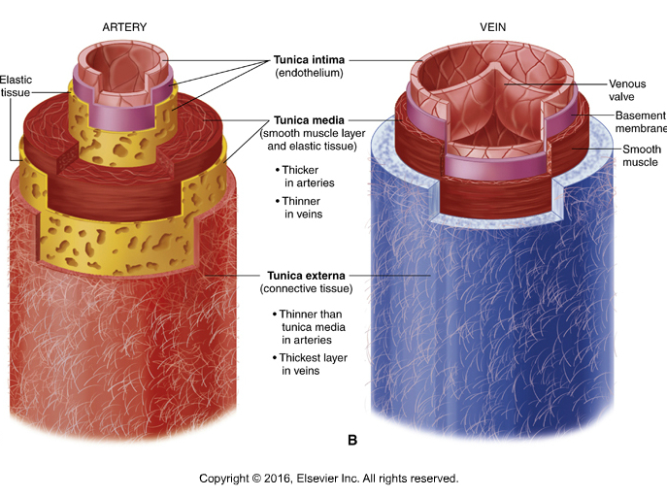
Blood Vessel Anatomy
Outer layer – Tunica externa: thin layer of fibrous elastic connective tissue
Middle layer – Tunica media: Smooth muscle
Inner layer – Tunica intima: single layer of squamous epithelial cells that line the inner surface of the entire cardiovascular system.
Notes:
The tunica media is thicker in arteries than it is in veins.
The connective tissue fibers of the outer wall reinforce the wall of the vessel so that it won’t burst under pressure.

Slide 16
Blood Vessel Functions
Arteries - Distribution of nutrients and gasses. Movement of blood under high pressure.
Capillaries - exchange vessels for nutrients, wastes, and fluids
Veins - Collect blood for return to the heart. Low pressure vessels.

Slide 17
Routes of Circulation
Pulmonary circulation
Systemic Circulation
Carries blood to and from the lungs
Arteries deliver deoxygenated blood to the lungs for gas exchange
Path goes from right ventricle through pulmonary arteries, lungs, pulmonary veins, to left atrium
Carries blood throughout the body
Path goes from left ventricle through aorta, smaller arteries, arterioles, capillaries, venules, venae cava, to right atrium.
Notes:
Blood Circulation
Refers to the flow of blood through all the vessels, which are arranged forming a complete circuit or circular pattern.

Slide 18
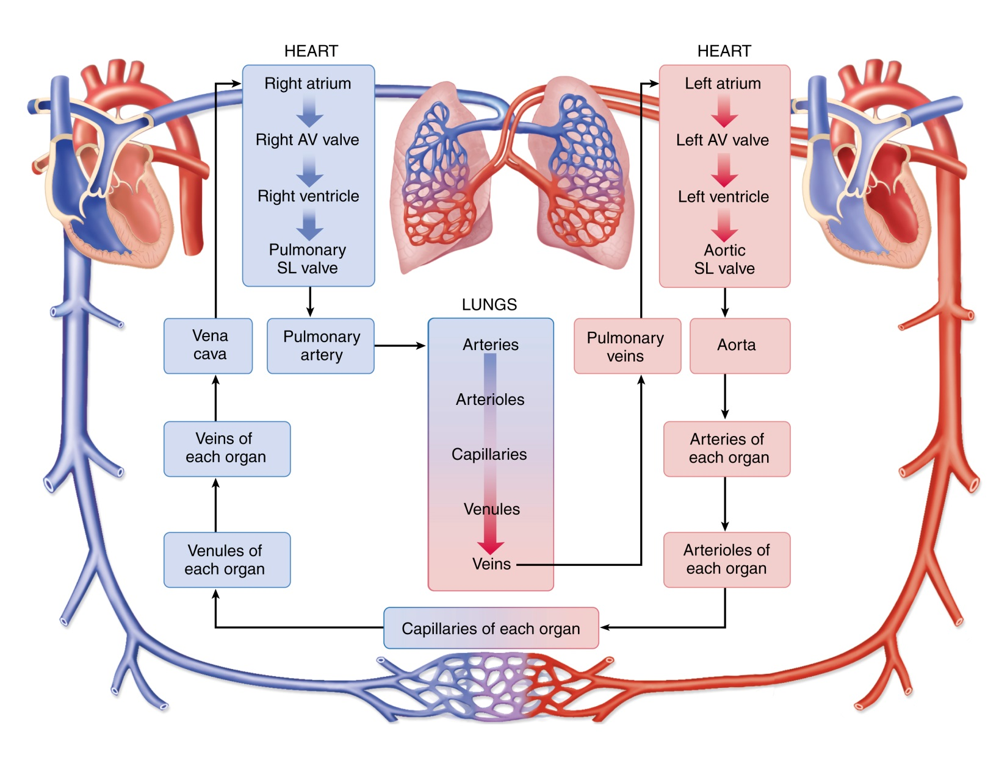
Notes:
This diagram of blood flow in the cardiovascular system shows the blood leaving the heart through the arteries and then traveling through the arterioles, capillaries, venules, and veins before returning to the opposite side of the heart.

Slide 19
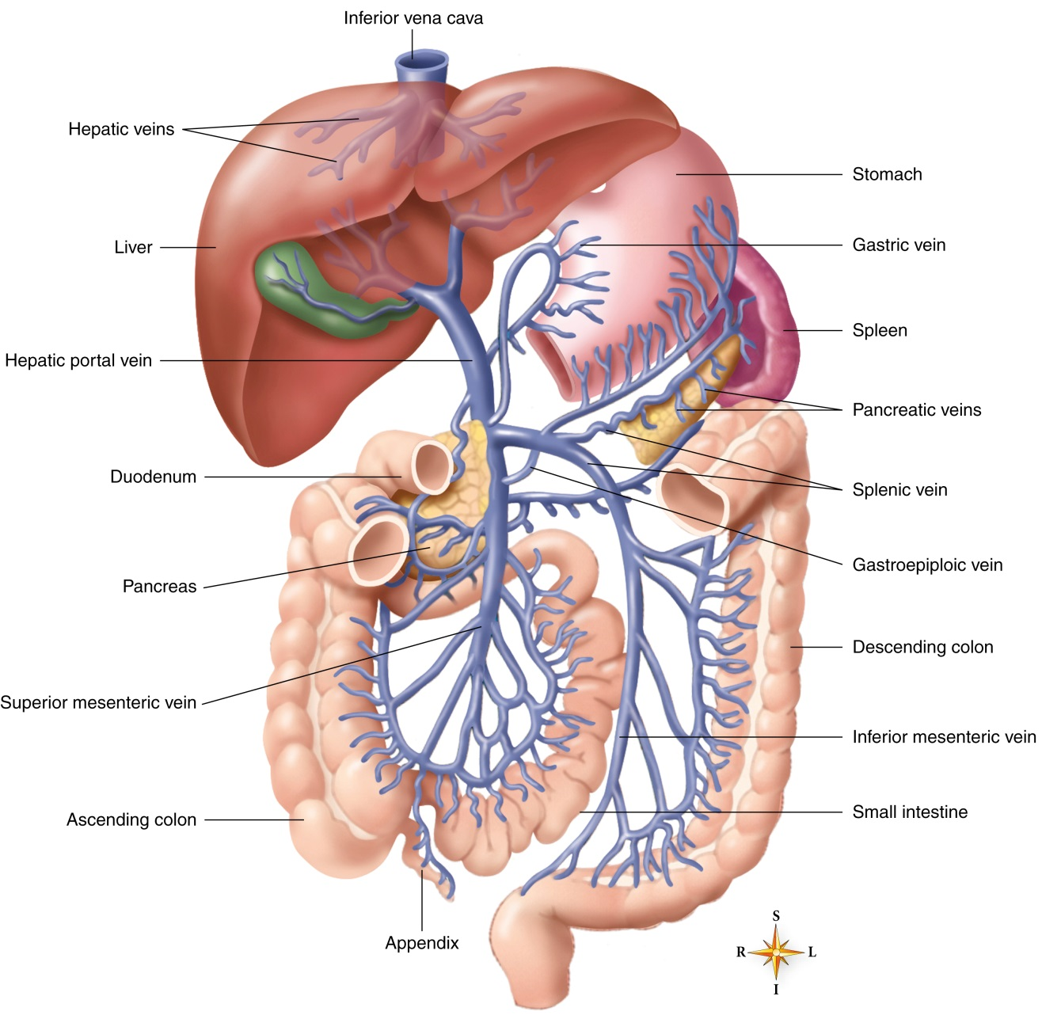
Hepatic Portal Circulation
Unique blood route through the liver
Vein (hepatic portal vein) exists between two capillary beds
Assists with homeostasis of blood glucose levels and acts as a second filter
Notes:
The term portal means “doorway.”
Veins from the spleen, stomach, pancreas, gallbladder, and intestines do not pour their blood directly into the inferior vena cava.
The hepatic portal system is an excellent example of how “structure fits function” in helping the body maintain homeostasis.

Slide 20
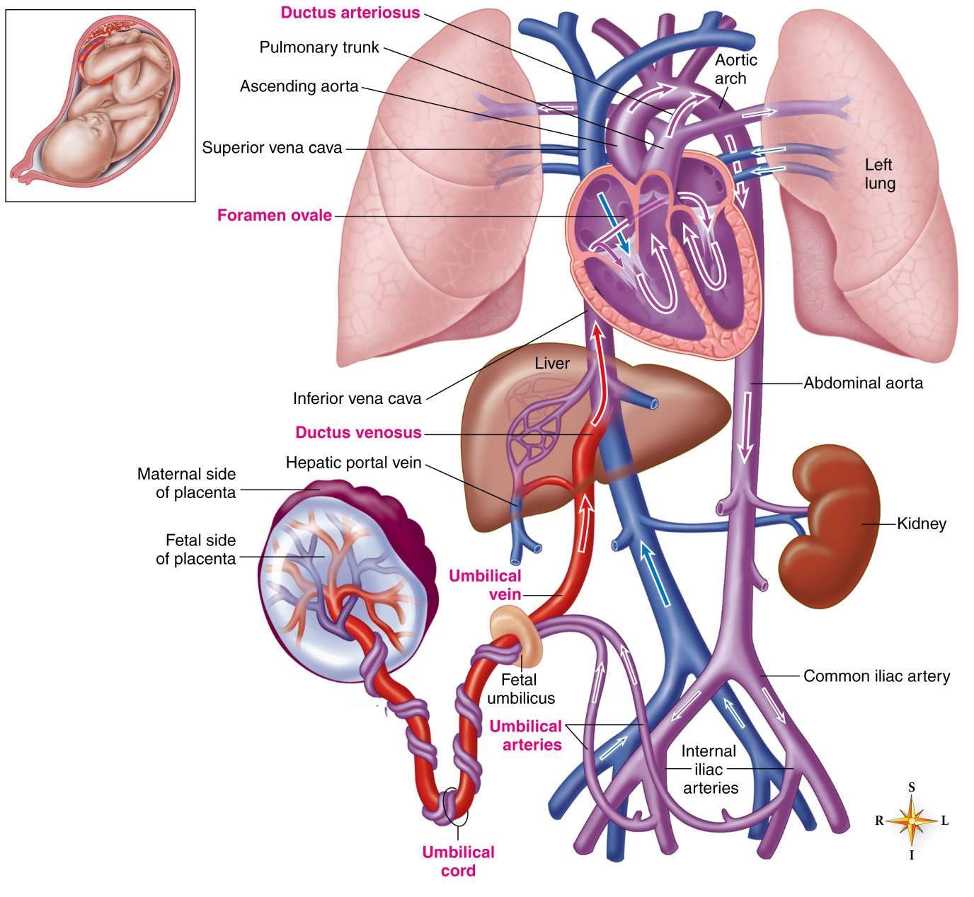
Fetal Circulation
Refers to circulation before birth
Modifications required for fetus to efficiently secure oxygen and nutrients from the maternal blood
Unique structures include the placenta, umbilical arteries and vein, ductus venosus, ductus arteriosus, and foramen ovale
Blood vessels must carry the fetal blood to the placenta (where exchange occurs) and then return it to the fetal body.
Notes:
Two small umbilical arteries and an umbilical vein are the three vessels that accomplish the exchange.
The ductus venosus is the continuation of the umbilical vein, and it serves as a shunt.

Slide 21
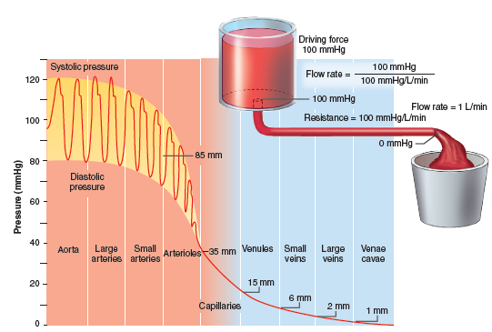
Hemodynamics
Defining blood pressure
Push, or force, of blood in the blood vessels
Highest in arteries, lowest in veins
Blood pressure gradient causes blood to circulate
Liquids can flow only from the area where pressure is higher to where it is lower.
Notes:
The blood pressure gradient is the difference between two blood pressures.
The mean blood pressure in the aorta is 100 millimeters of mercury (mm Hg).

Slide 22
Hemodynamics (continued)
Blood volume
The larger the volume, the more pressure is exerted on vessel walls
Strength of heart contractions
Affect cardiac output
Stronger heartbeat increases pressure
Weaker beat decreases it
Heart rate
Increased rate increases pressure
Decreased rate decreases pressure
Notes:
The direct cause of blood pressure is the volume of blood in the vessels.
The less blood there is in the arteries, the lower the blood pressure will be.

Slide 23
More Hemodynamics
Fluctuations in arterial blood pressure
Blood pressure varies within normal range
Normal average arterial blood pressure is 120/80
Central venous blood pressure
Venous return of blood to the heart depends on five mechanisms:
A strongly beating heart
An adequate arterial blood pressure
Valves in the veins
Pumping action of skeletal muscles as they contract
Changing pressures in the chest cavity caused by breathing
Notes:
“Normal” blood pressure fluctuates with age and varies among individuals.
The central venous pressure level is important because it influences the pressure that exists in the large peripheral veins.
If the heart is weakened, central venous pressure increases, and the flow of blood into the right atrium is slowed.

Slide 24
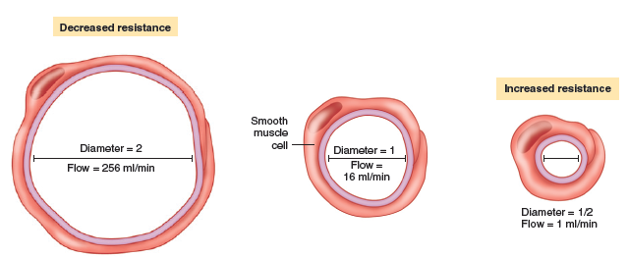
Factors that influence BP
Blood viscosity (thickness)
Less than normal viscosity decreases pressure
More than normal viscosity increases pressure
Resistance to blood flow (peripheral resistance [PR])
Affected by many factors, including the vasomotor mechanism (vessel muscle contraction/relaxation)
Notes:
Figure 13-23 shows the vasomotor mechanism, including smooth muscle relaxation, normal resting tone, and smooth muscle contraction.

Slide 25
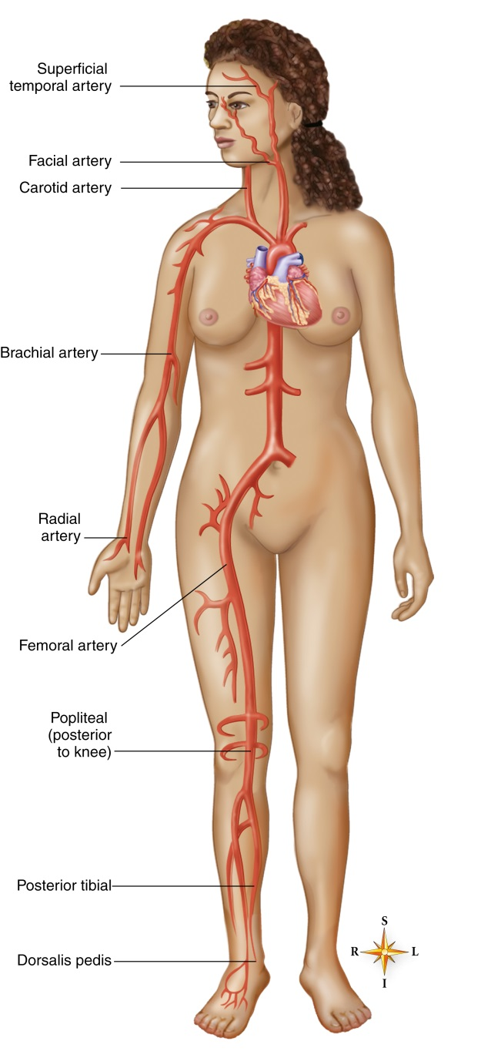
Pulse
Definition
Alternate expansion and recoil of the blood vessel wall
Nine major “pulse points”
Named after arteries over which they are felt (Figure 13-24)
Notes:
Three pulse points are located on each side of the head and neck, three points in the upper limb, and three points in the lower extremity.
Radial pulse (wrist) is the most frequently monitored and easily accessible in the body.

