Slide 1
Chapter 11: Endocrine System
A&P130 North-West College
Ms. Escoto

Slide 2
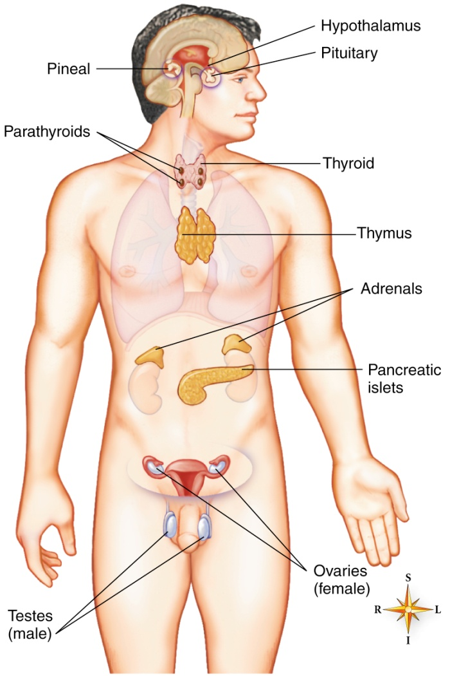
What is the Endocrine System?
Primarily functions as a communication and control center, similar to the nervous system.
The endocrine system provides slower but longer-lasting control by way of hormones secreted and circulated by the blood.
Hormones – chemicals secreted by endocrine glands that trigger a reaction.
Endocrine glands secrete hormones to bind to a cell that has specific receptors for that hormone, this is called a target cell.

Slide 3
Endocrine and Exocrine Glands
All organs of the endocrine system are glands, but not all glands are organs of the endocrine system
Two types of glands in the body
Exocrine glands
Endocrine glands
Only endocrine glands belong to the endocrine system as they secrete hormones.

Slide 4
2 Major Classes of Hormones
Nonsteroid Hormones
Steroid hormones
Whole proteins, shorter chains of amino acids, simply versions of single amino acids. Serve as first messengers.
Do not enter cells, but bind to membranes to activate second messenger mechanisms.
Activate second messenger mechanism that provides communication within the actual target cell.
Ex. Cyclic AMP
Small, lipid-soluble that pass intact directly though the plasma membrane of the target cell.
Pass through the cytoplasm
Enter the nucleus where they bind with a receptor to form a hormone-receptor complex that produces a new protein that effects the target cell.
Ex. Estrogen
Notes:
Nonsteroid hormones:
think lock and key
message leaves gland and goes directly to target cell which activates molecule within target cell called second messengers.
Cyclic AMP - ATP molecules changed to cyclic AMP which serves as the second messenger, delivering info inside the ell that regulates the cell’s activity.

Slide 5
Mechanisms of Hormone Action – Which process is nonsteroid? Steroid?
Notes:
Left. Nonsteroid – second messenger, hormone does not enter membrane.
Right Steroid – enters nucleus, hormone creates protein that produces effect on target cell.

Slide 6
Regulation of Hormone Secretion
Negative Feedback
Positive feedback
Mechanisms that reverse the direction of a change in a physiological system.
Ex. Insulin.
When released from pancreas, insulin lowers glucose concentration.
They reverse the direction of a disturbance to the stability of the internal environment of the body.
Less common.
Amplify physiological changes rather than reverse them.
Ex. Muscle contractions in labor
Muscle contractions during labor become stronger by the release of oxytocin.

Slide 7
Negative Feedback

Slide 8
Prostaglandins
Prostaglandins are powerful substances found in a wide variety of body tissues, also known as tissue hormones.
Act locally within a tissue influencing body functions including respiration, blood pressure, gastrointestinal secretions, and reproduction. PGs, along with several other tissue hormones, are sometimes called paracrine agents.
It is different from actual hormones because it influences only a small radius around the tissue in which it is produced.
Notes:
PGs, along with several other tissue hormones, are sometimes called paracrine agents.

Slide 9
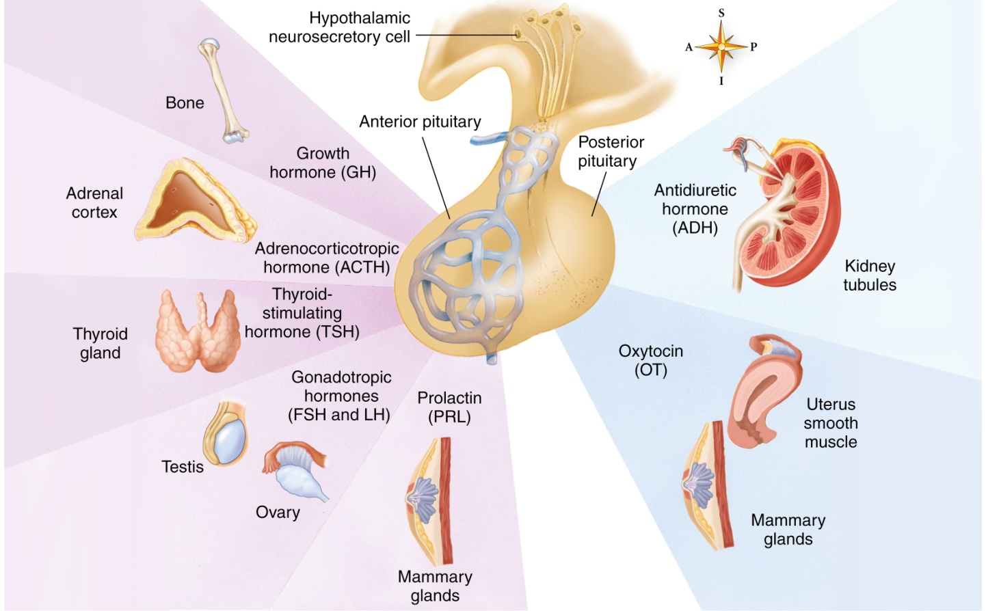
Pituitary Gland
Anterior pituitary gland – adenohypophysis (“gland”)
Thyroid-stimulating hormone (TSH)
Adrenocorticotropic hormone (ACTH)
Follicle-stimulating hormone (FSH)
Luteinizing hormone (LH)
Growth hormone (GH)
Prolactin (PRL); lactogenic hormone
Posterior pituitary gland – neurohypophysis (“nervous”)
controls release of Oxytocin and ADH.
Notes:
Structure of the pituitary gland
Because the anterior pituitary gland exerts tropic control over the structure and function of the thyroid gland, the adrenal cortex, the ovarian follicles, and the corpus luteum, it was sometimes called the master gland.

Slide 10
Major Hormones
TSH
Stimulates growth of the thyroid gland; also stimulates it to secrete thyroid hormone
ACTH
Stimulates growth of the adrenal cortex and stimulates it to secrete glucocorticoids (mainly cortisol)
FSH
Initiates growth of ovarian follicles each month in the ovary and stimulates one or more follicles to develop to the stage of maturity and ovulation
Stimulates estrogen secretion by developing follicles
Stimulates sperm production in the male
Oxytocin (OT)
Stimulates the pregnant uterus to contract
May initiate labor
Causes glandular cells of the breast to release milk into ducts
Enhances social bonding

Slide 11
Major Hormones (continued)
LH
Acts with FSH to stimulate estrogen secretion and follicle growth to maturity
Causes ovulation
Causes luteinization of the ruptured follicle and stimulates progesterone secretion by corpus luteum
Causes interstitial cells in the testes to secrete testosterone in the male
GH
Stimulates growth by accelerating protein anabolism
Accelerates fat catabolism and slows glucose catabolism
By slowing glucose catabolism, tends to increase blood glucose to higher than normal level (hyperglycemia)
PRL
Stimulates breast development during pregnancy and secretion of milk after the delivery of the baby
Antidiuretic hormone (ADH)
Accelerates water reabsorption from urine in the kidney tubules into the blood, thereby decreasing urine secretion

Slide 12
Hypothalamus
What does it secrete?
What is its function?
Production of ADH and oxytocin occurs in the hypothalamus
After production in the hypothalamus, hormones pass along axons into the pituitary gland
The hypothalamus controls many body functions related to homeostasis (temperature, appetite, and thirst)

Slide 13
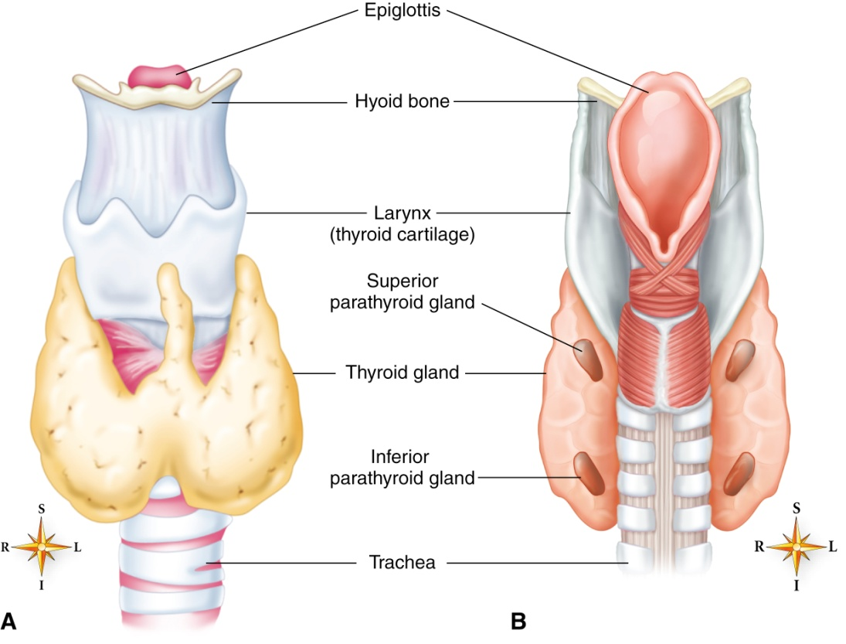
Thyroid Gland and Parathyroid Gland
Thyroid hormones include:
Thyroxine
Trioodothyronine
Function:
Accelerates catabolism and increases the body’s metabolic rate.
Parathyroid hormone: (PTH) increases blood calcium concentration by increasing breakdown of bone with the release of calcium into blood.

Slide 14
Regulation of Blood Ca+
Notes:
Calcitonin and parathyroid hormones have antagonistic (opposite) effects on calcium concentration in the blood.

Slide 15
Adrenal Cortex
Zones of the adrenal cortex:
Corticoids: Hormones secreted by all three cell layer zones.
Outer zone secretes mineralocorticoids (MCs): Chiefly aldosterone.
Middle secretes glucocorticoids (GCs): Chiefly cortisol (hydrocortisone).
Innermost/deepest zone secretes sex hormones: Small amounts of male hormones (androgens) secreted by adrenal cortex of both sexes
Cortisol: The chief glucocorticoid (GC).
Aldosterone: The chief mineralocorticoid.
Notes:
Adrenal cortex:
The outer zone of the adrenal cortex cells secretes hormones called mineralocorticoids. The main mineralocorticoid is the hormone aldosterone.
The middle zone secretes glucocorticoids. The chief glucocorticoid is cortisol.
The innermost or deepest zone of the cortex secretes small amounts of sex hormones.

Slide 16
The Adrenal Gland

Slide 17
Functions of Mineralocorticoid
MCs increase blood sodium and decrease body potassium concentrations by accelerating kidney tubule reabsorption of sodium and excretion of potassium.
What is the chief Mineralocorticoid?
Aldosterone

Slide 18
Function of Glucocorticoid
Helps maintain normal blood glucose concentration.
Increases gluconeogenesis: formation of new glucose
Maintains normal BP
Epinephrine and norepinephrine maintain vasoconstriction.
Anti-inflammatory effect
Work with epinephrine and norepinephrine
Anti-immunity and anti-allergy effect.
Decrease number of antibodies and WBCs
Stress response
High amounts of glucocorticoids in stress, so high blood concentration of glucocorticoids = stress management

Slide 19
Adrenal medulla
Secretes hormones
Epinephrine (Epi), or adrenaline, Norepinephrine (NR)
Functions of hormones
Help the body resist stress by intensifying and prolonging the effects of sympathetic stimulation
Increased epinephrine secretion is the first endocrine response to stress

Slide 20
Pancreatic Islets – produce two important hormones!
Glucagon
Insulin
Secreted by alpha cells
Increases the blood glucose level by accelerating liver glycogenesis (conversion of glycogen to glucose)
Secreted by beta cells
Decreases the blood glucose by accelerating the movement of glucose out of the blood into cells, which increases glucose metabolism by cells
Notes:
The pancreatic islets are also known as the islets of Langerhans.
These glands are little clumps of cells scattered like islands in a sea among the exocrine cells of the pancreas.
If the pancreatic islets secrete too little insulin (type 1 diabetes mellitus), less glucose leaves the blood to enter the cells, so blood glucose increases dramatically.
Most cases of type 2 diabetes mellitus result from decrease of insulin and an abnormality of the insulin receptors.

Slide 21
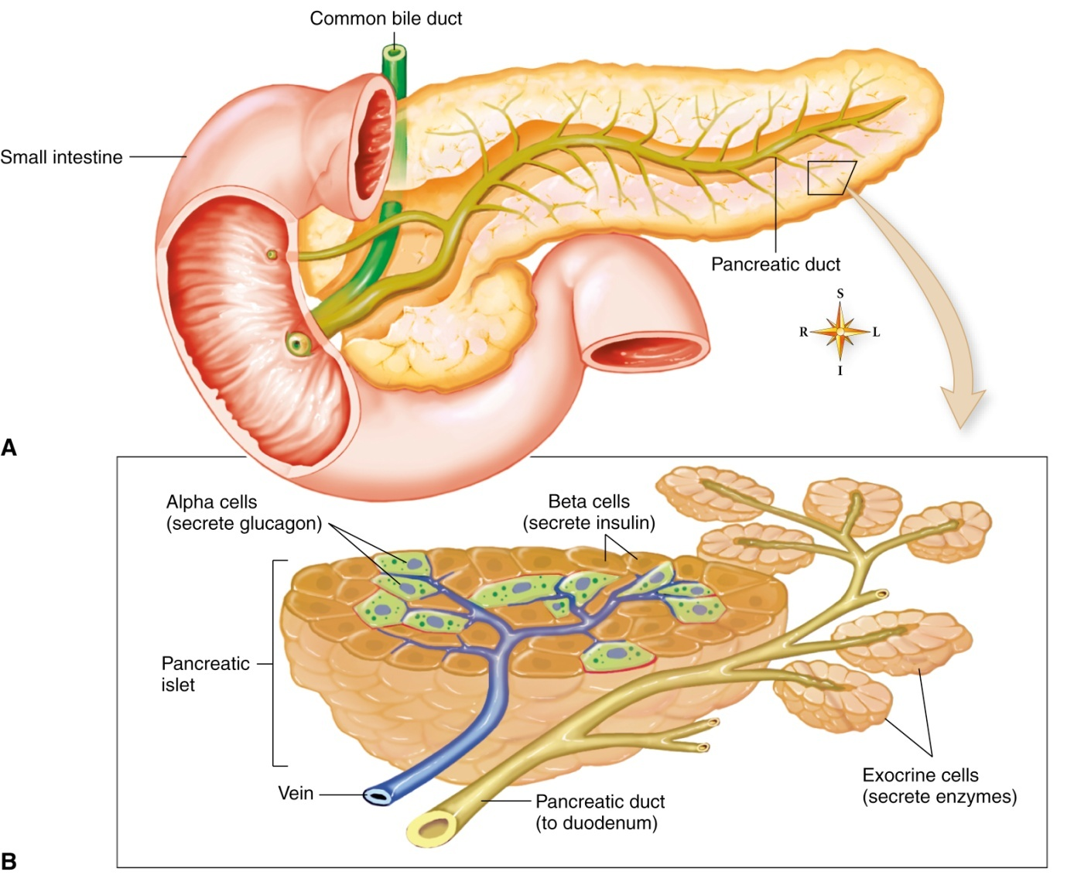

Slide 22
Sex Glands
Female Sex Glands
Male Sex Glands
The ovaries contain two structures that secrete hormones:
ovarian follicles and corpus luteum.
Effects of estrogen (feminizing hormone)
Development and maturation of breasts and external genitals
Development of adult female body contours
Initiation of menstrual cycle
The interstitial cells of testes secrete the male hormone testosterone
Effects of testosterone (masculinizing hormone)
Maturation of external genitals
Beard growth
Voice changes at puberty
Development of musculature and body contours typical of the male

Slide 23
Thymus
Name of hormone
Thymosin
Function of hormone
Plays an important role in the development and function of the body’s immune system

Slide 24
Placenta
Produces hormones
Chorionic gonadotropins
Estrogen
Progesterone
Function of hormones
Maintain the corpus luteum during pregnancy

Slide 25
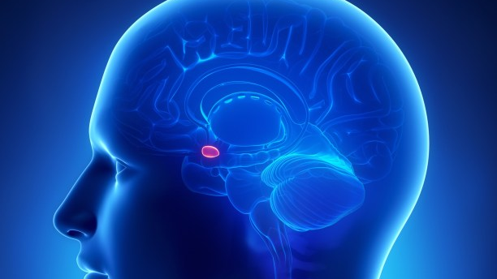
Pineal Gland
A small gland near the roof of the third ventricle of the brain
Glandular tissue predominates in children and young adults
Becomes fibrous and calcified with age
Called the third eye because its influence on secretory activity is related to the amount of light entering the eyes
Secretes melatonin, which:
Inhibits ovarian activity
Regulates the body’s internal clock

Slide 26
Endocrine Functions Throughout the Body
Many organs (e.g., the stomach, intestines, and kidney) produce endocrine hormones
Stomach lining produces ghrelin, which affects appetite and metabolism
The atrial wall of the heart secretes atrial natriuretic hormone (ANH), which stimulates sodium loss from the kidneys
Fat-storing cells secrete leptin, which controls how full or hungry one feels

Slide 27
Endocrine Hormone Conditions
Gigantism - Hypersecretion of growth hormone during the early years of life
Diabetes insipidus - Hyposecretion of ADH
Goiter - Low dietary take of iodine
Cretinism - Hyposecretion of thyroid hormones during the formative years
Diabetes mellitus
Type 1
Pancreatic islets secrete too little insulin
Type 2
Decrease of insulin and an abnormality of the insulin receptors
Glycosuria - Excess glucose is filtered out of the blood and lost in the urine

Slide 28
Gigantism

Slide 29
Diabetes insipidus
Hyposecretion of ADH leads to a disorder of salt and water metabolism marked by intense thirst and heavy urination.
Netflix: Grey’s Anatomy Episode 10 Season 2
14:37 – 1st Scene
30:00 – 2nd Scene
Grey’s Anatomy Episode 11 Season 2
5:26 – 3rd Scene
39:20 – 4th Scene

Slide 30
Goiter – iron deficiency that may result in enlargement of Thyroid

